Slide 1
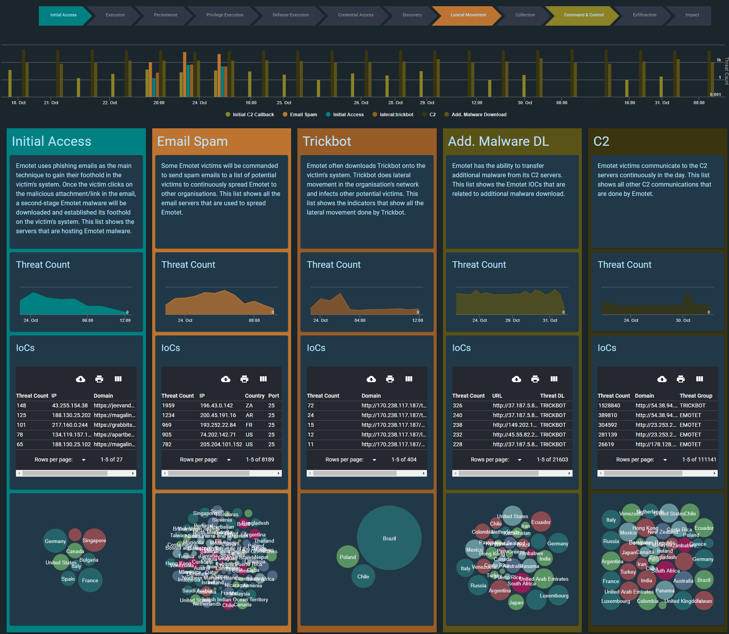

Slide 2
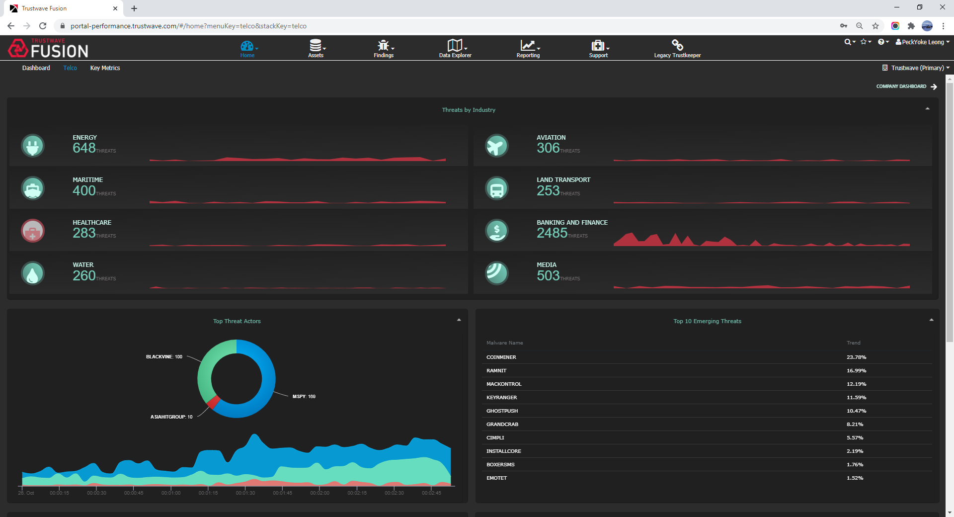

Slide 3
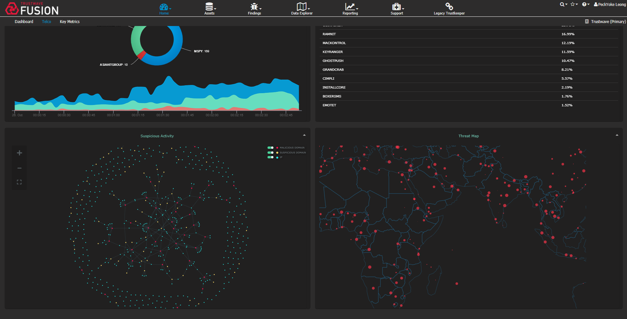

Slide 4
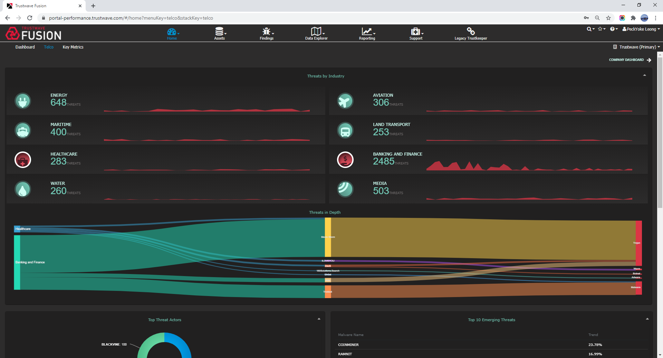

Slide 5
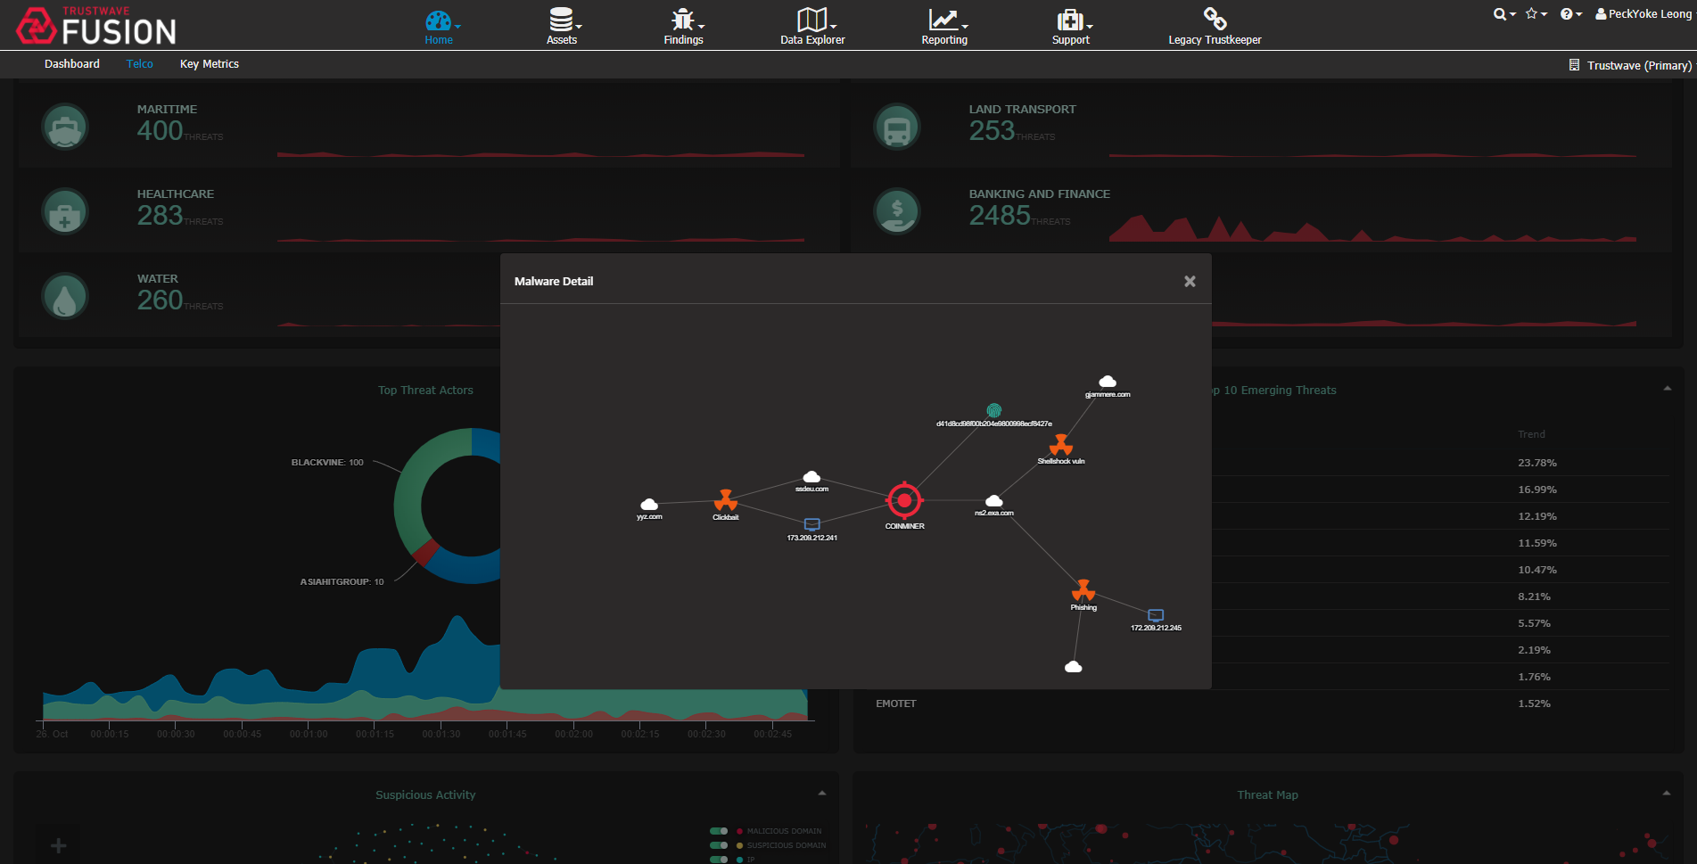

Slide 6
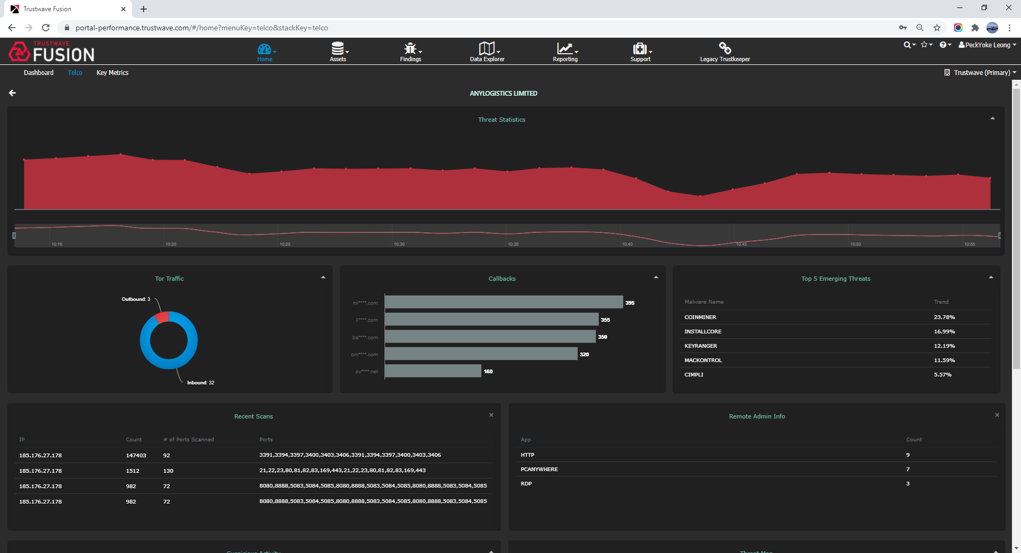

Slide 7
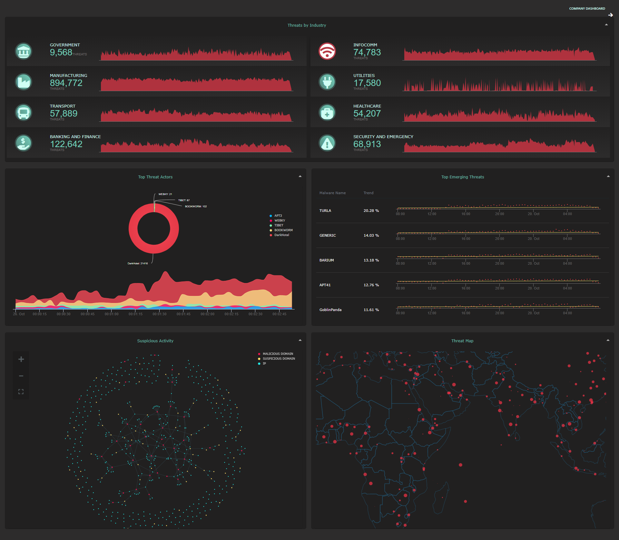
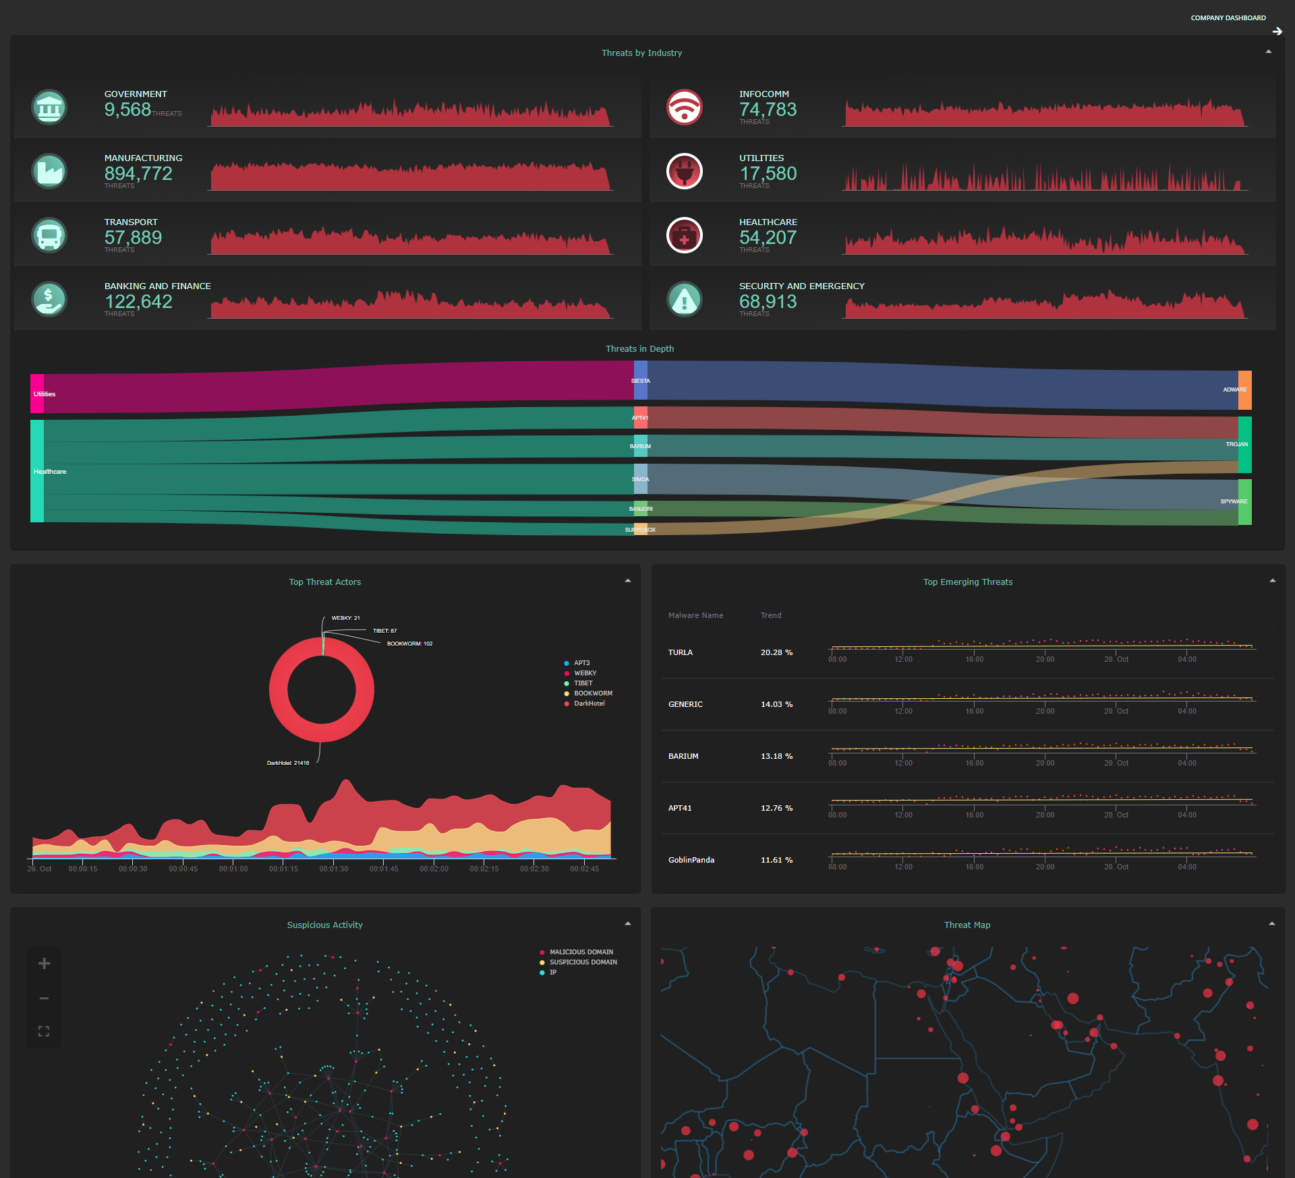

Slide 8
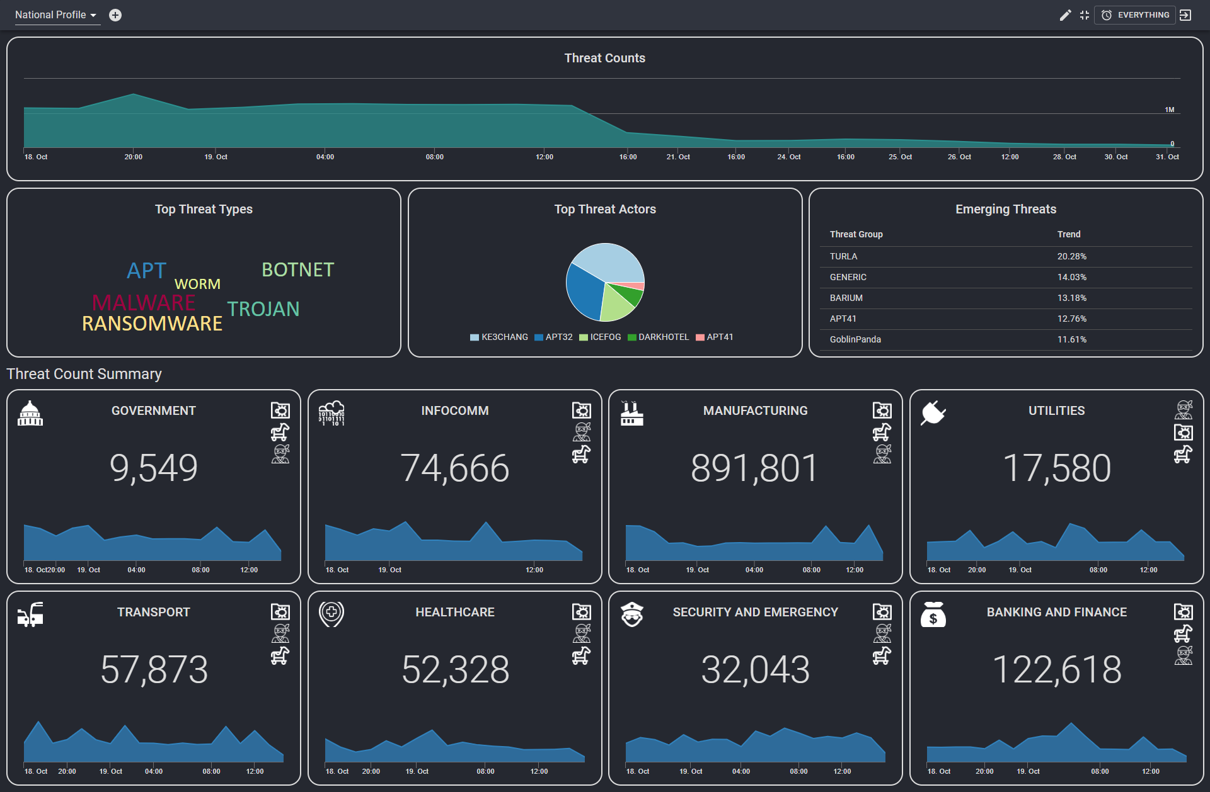

Slide 9
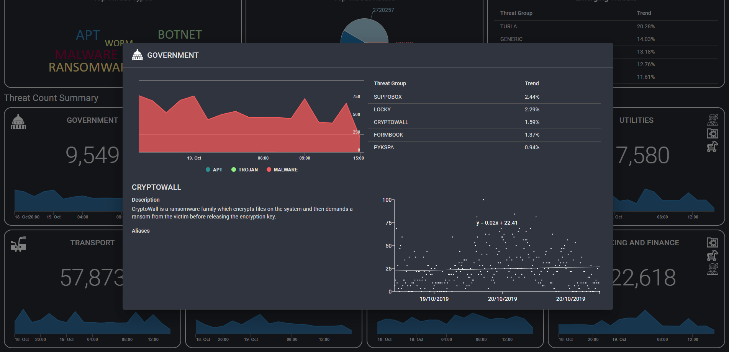

Slide 10
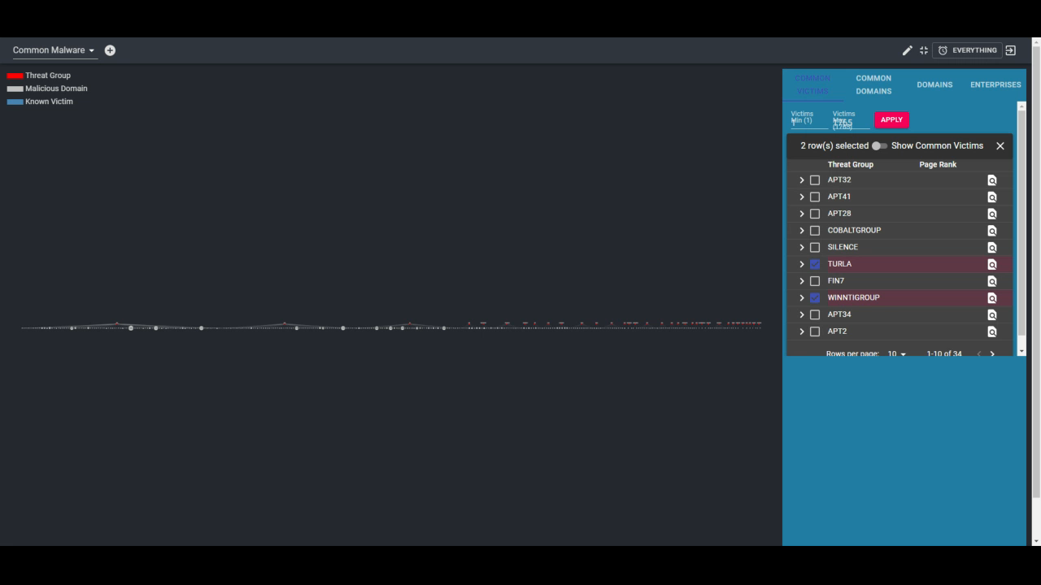
CommonMalware Video

Slide 11
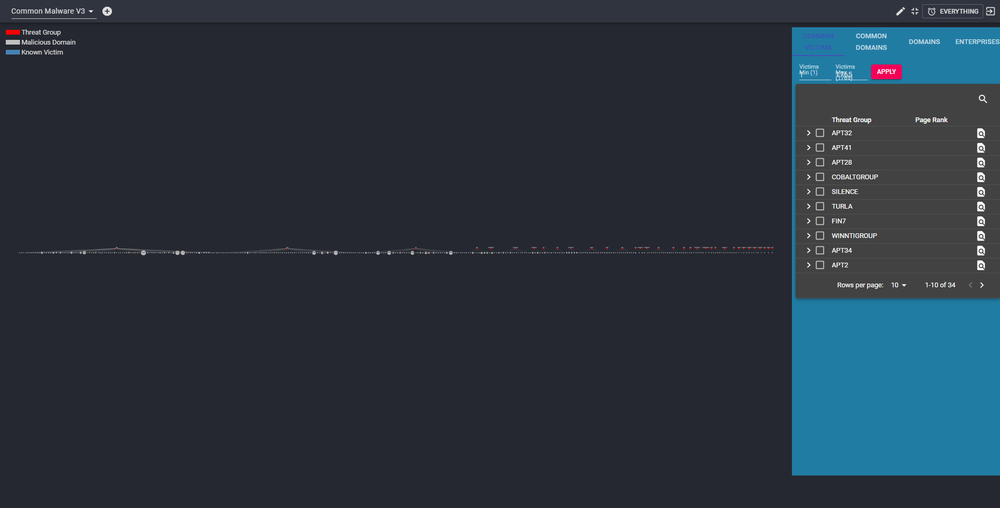
Search Box
Zoom to Threat

Slide 12
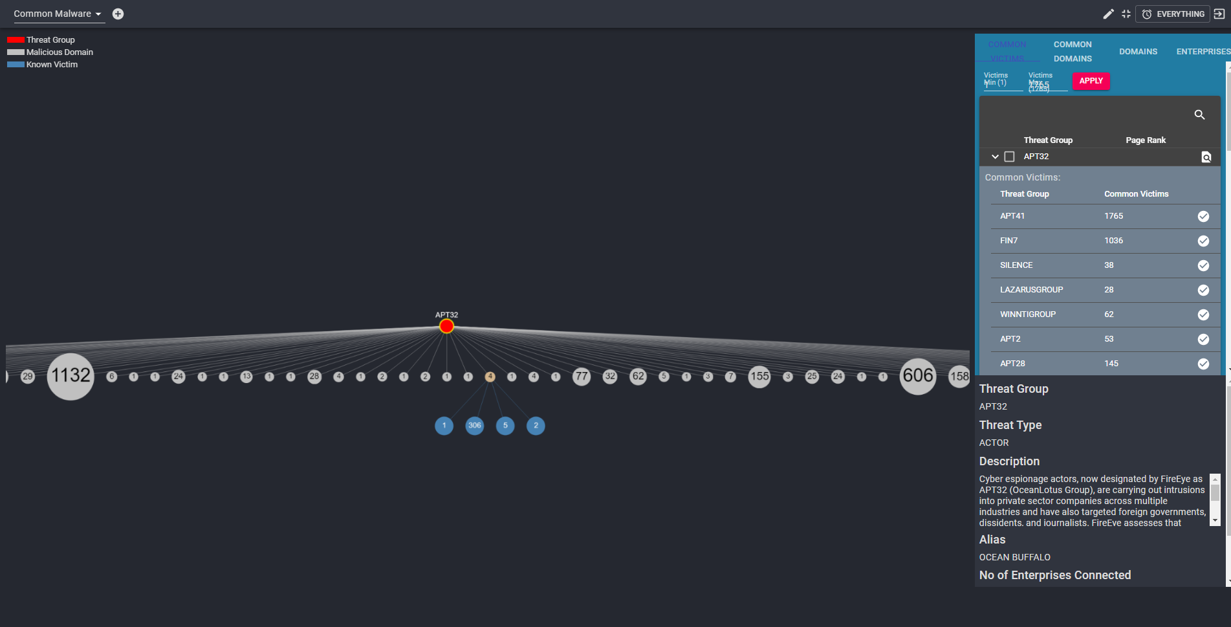
List of Threats with common victims to APT32

Slide 13
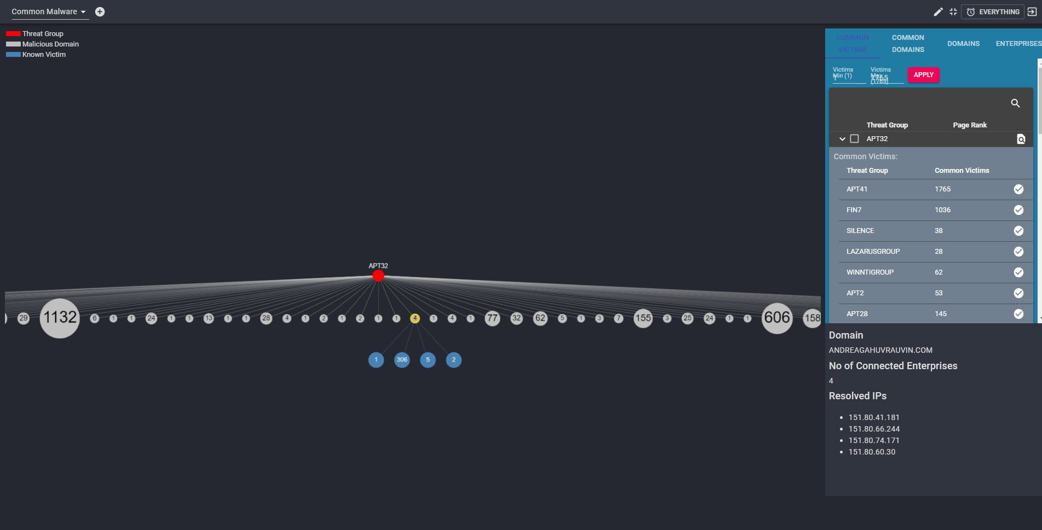

Slide 14
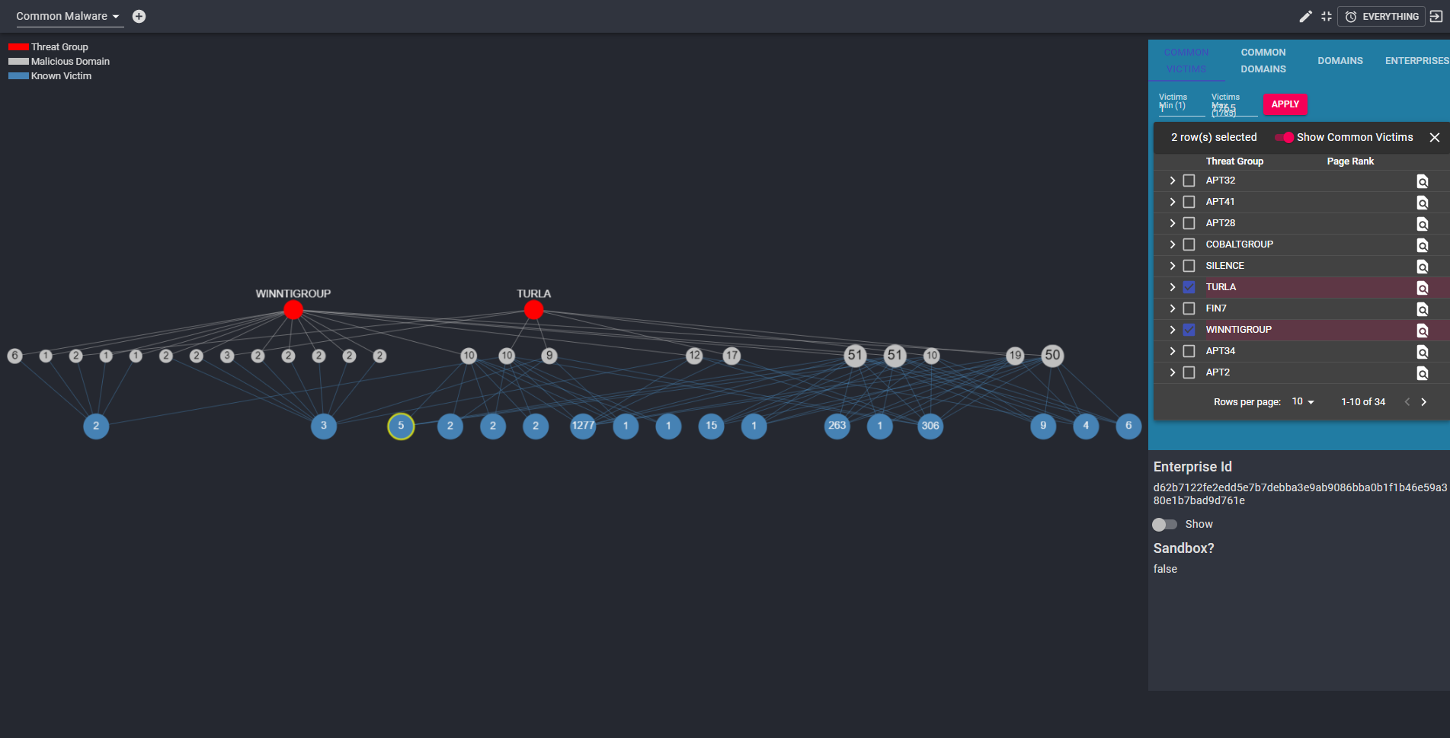

Slide 15
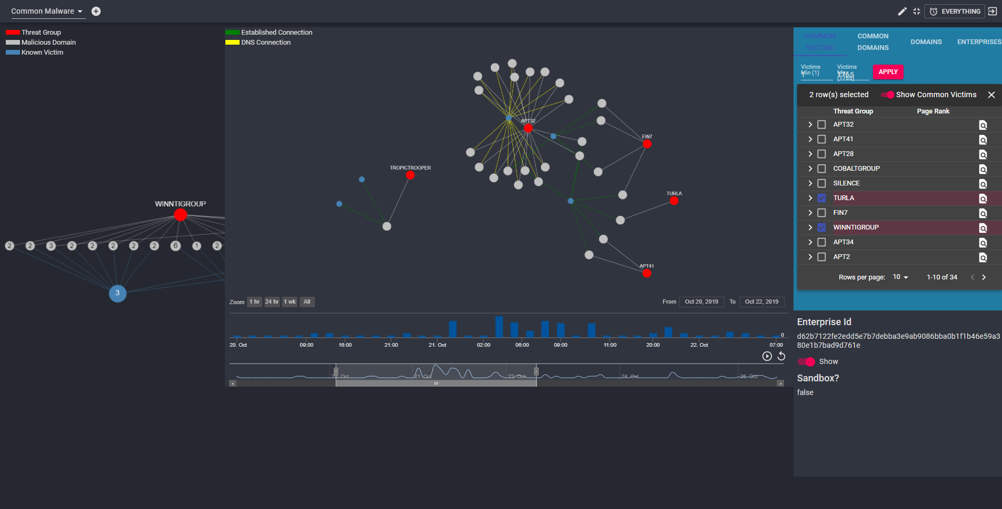

Slide 16
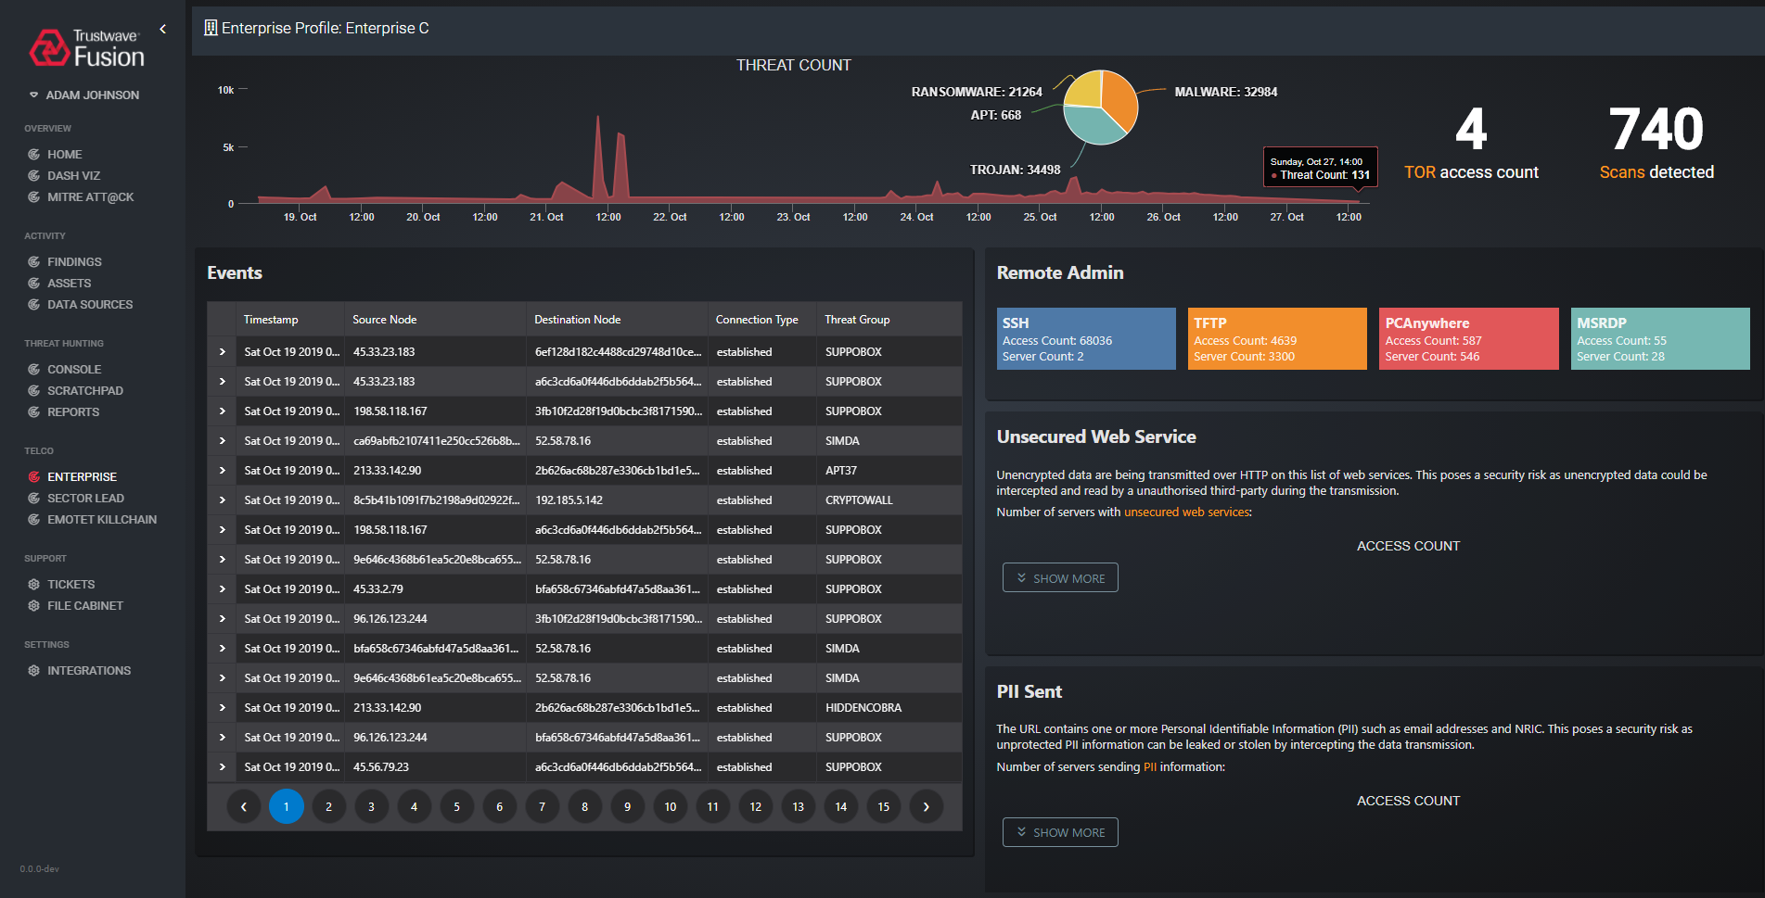

Slide 17
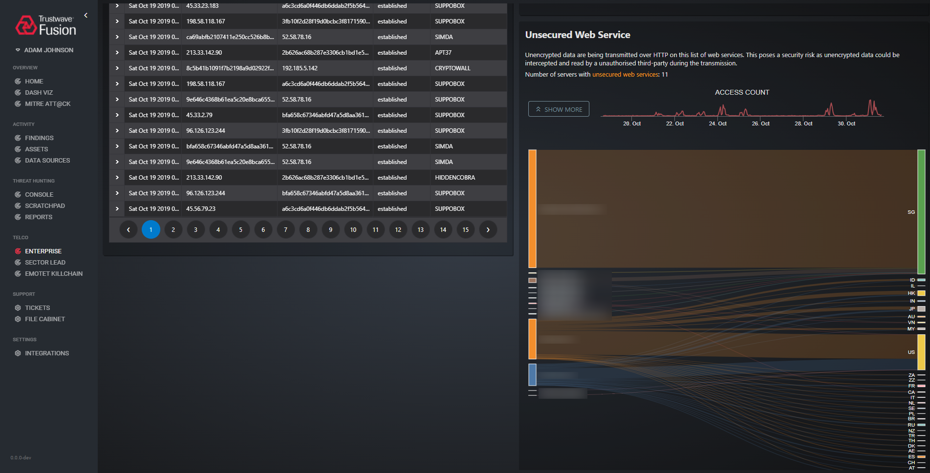

Slide 18
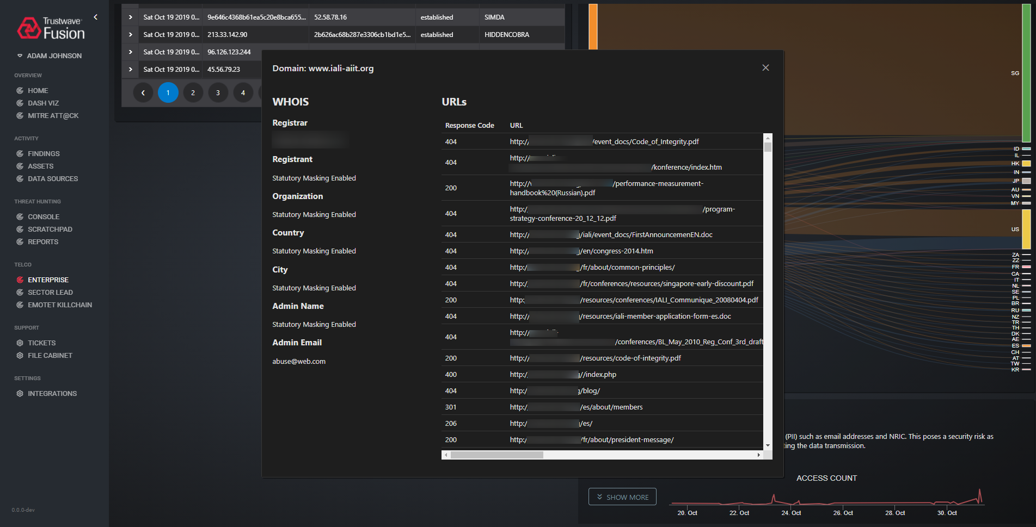

Slide 19
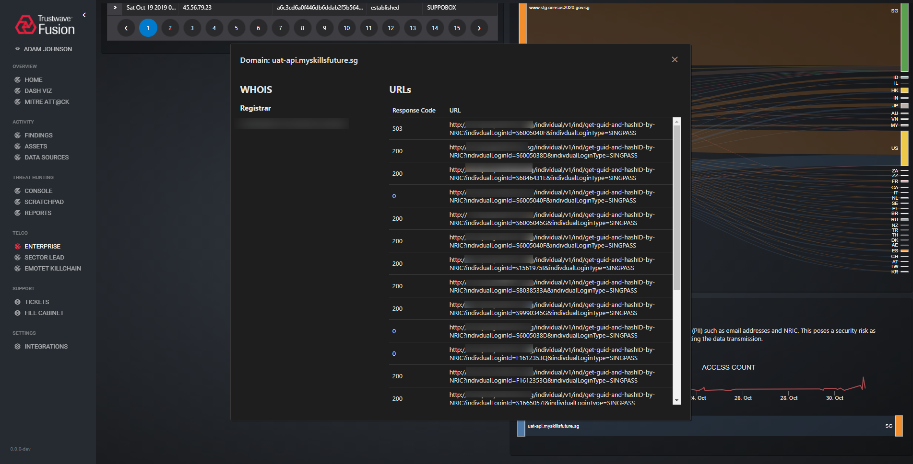

Slide 20
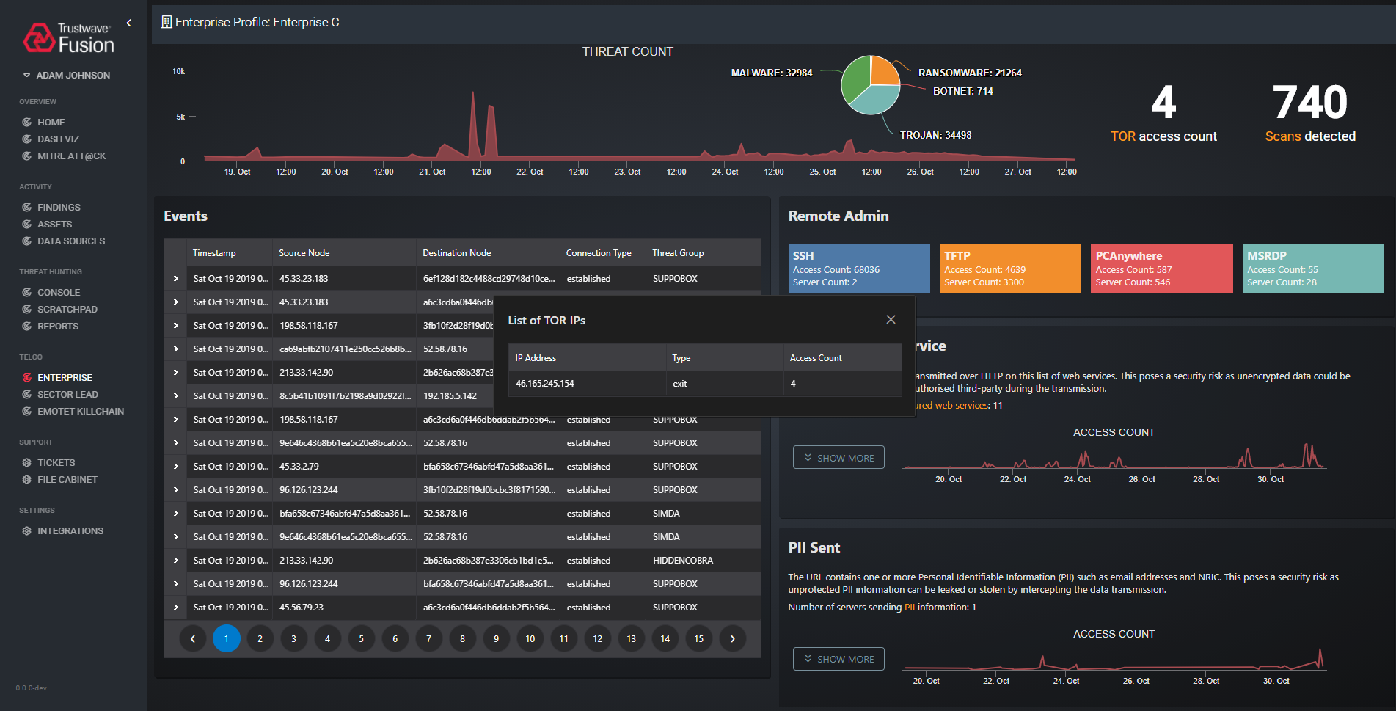

Slide 21
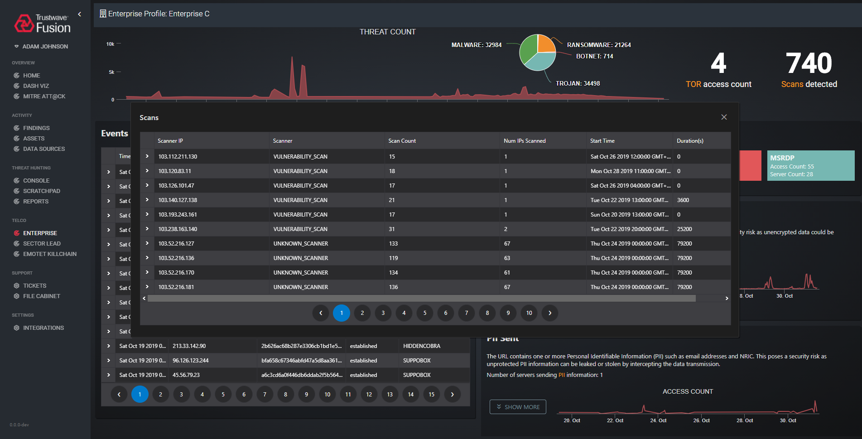

Slide 22
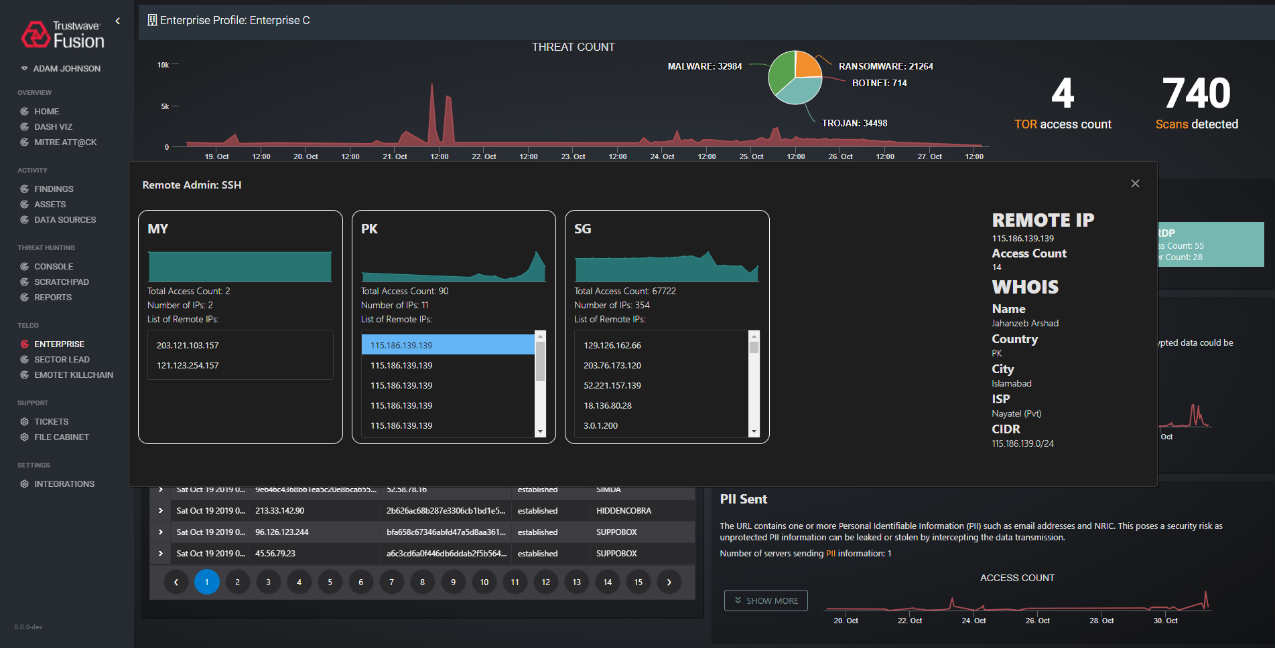

Slide 23
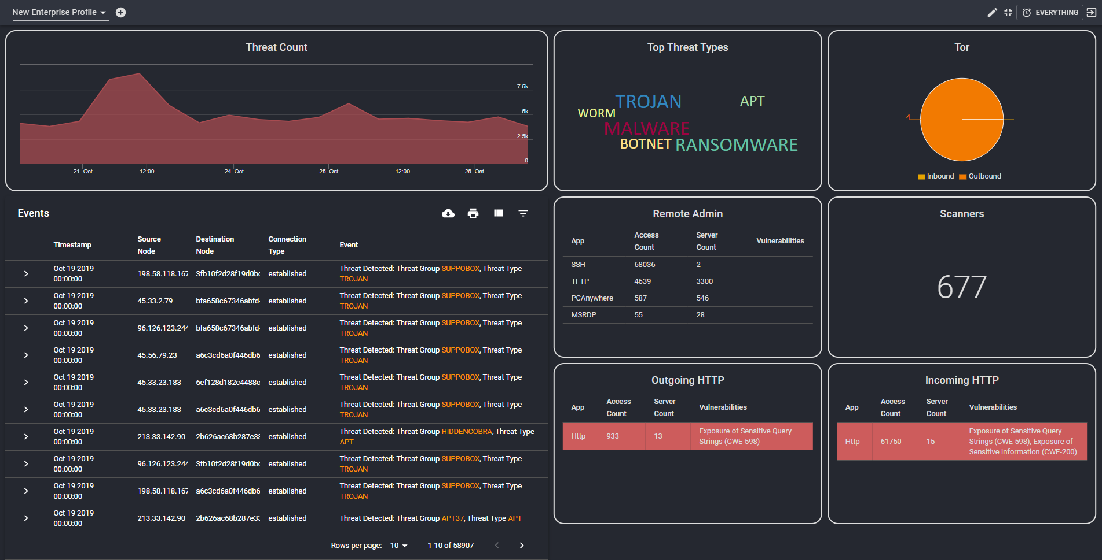

Slide 24
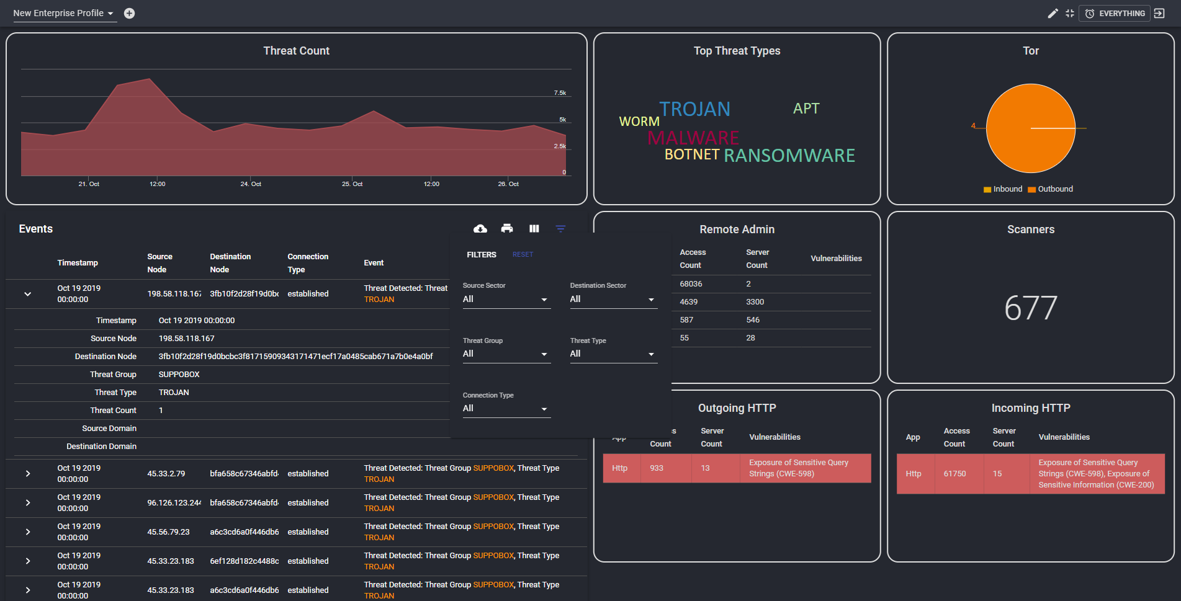

Slide 25


Slide 26
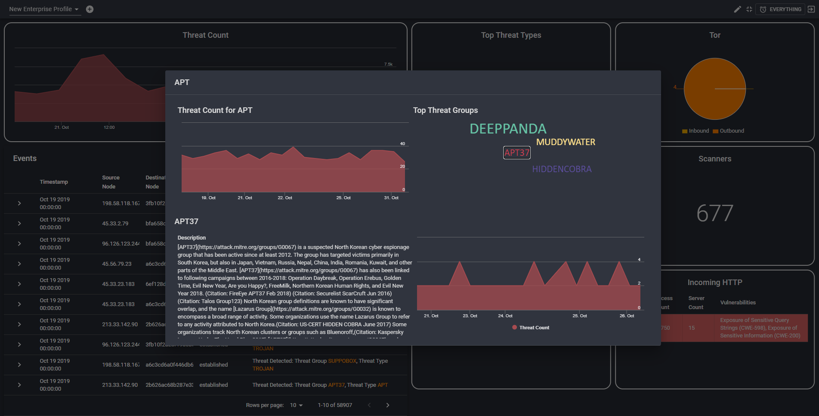

Slide 27
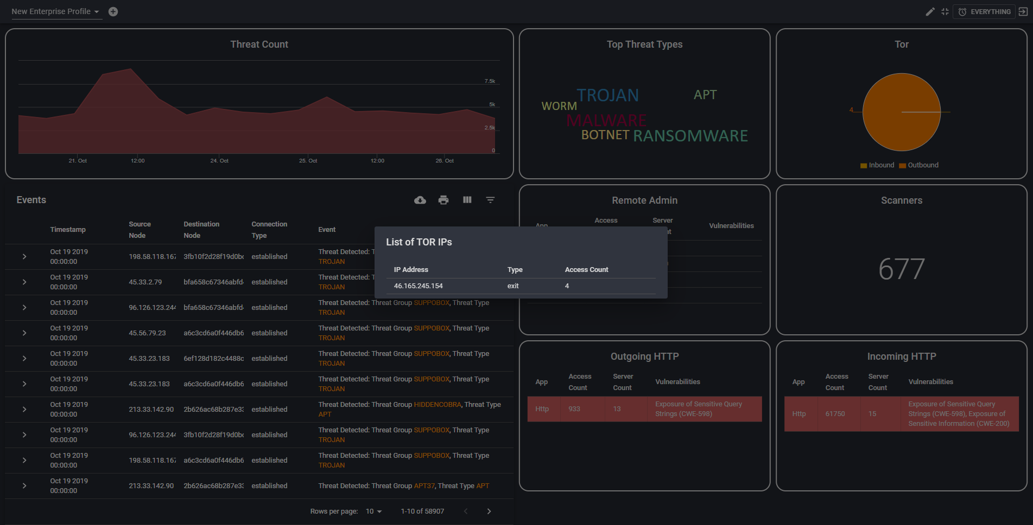

Slide 28


Slide 29
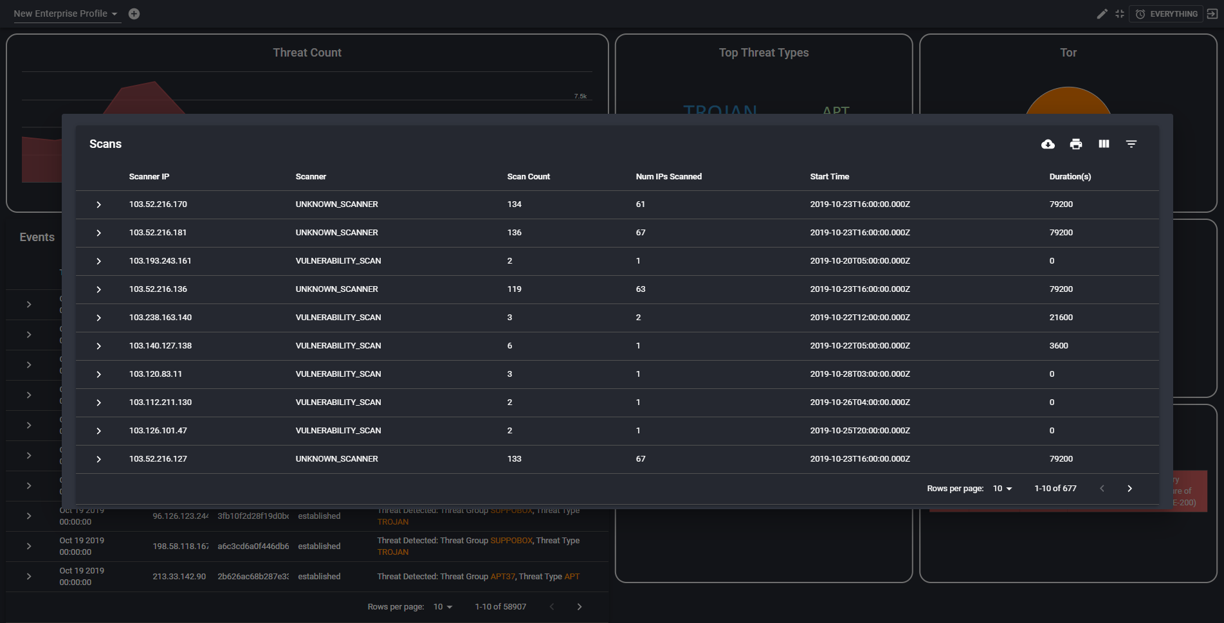

Slide 30
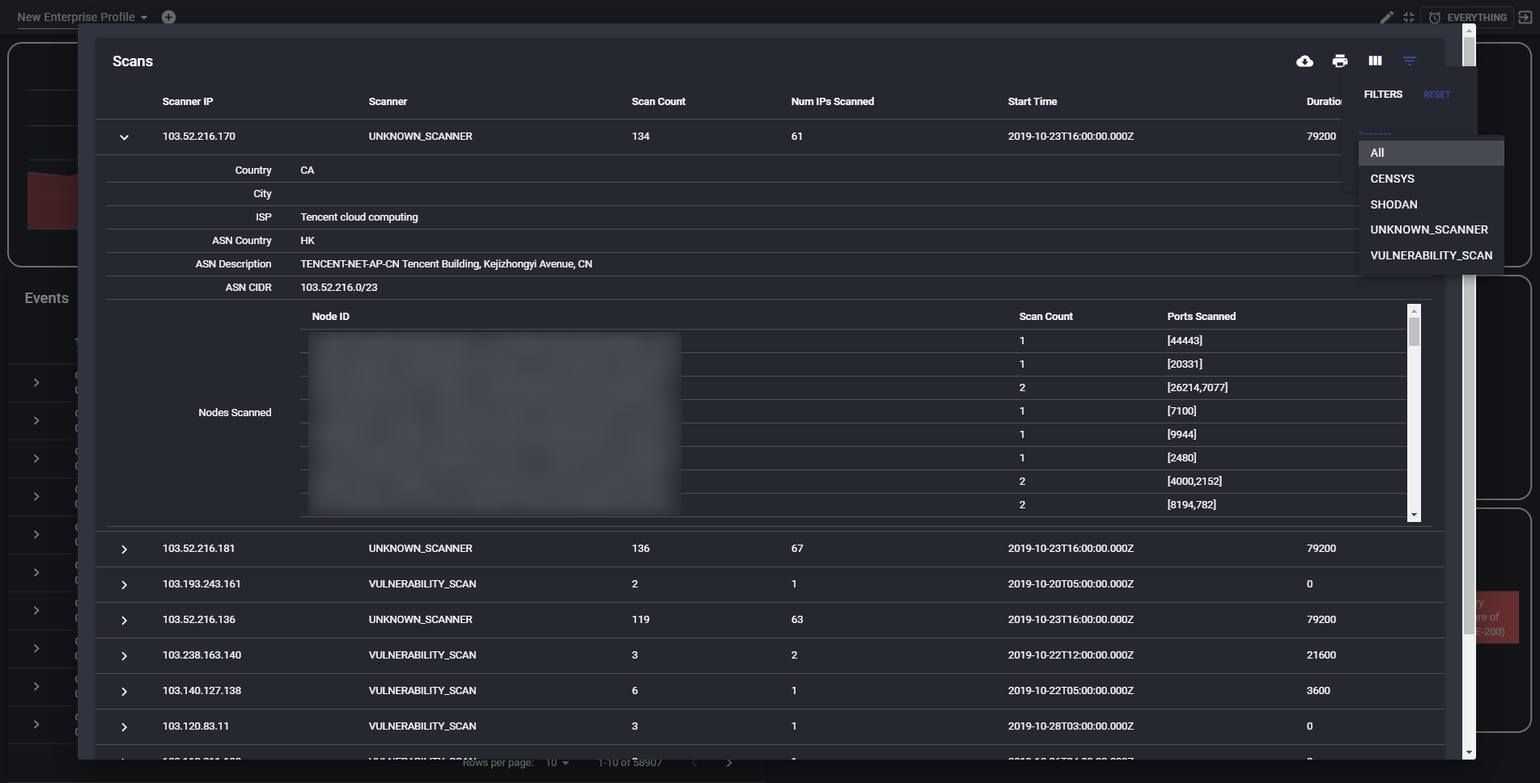

Slide 31
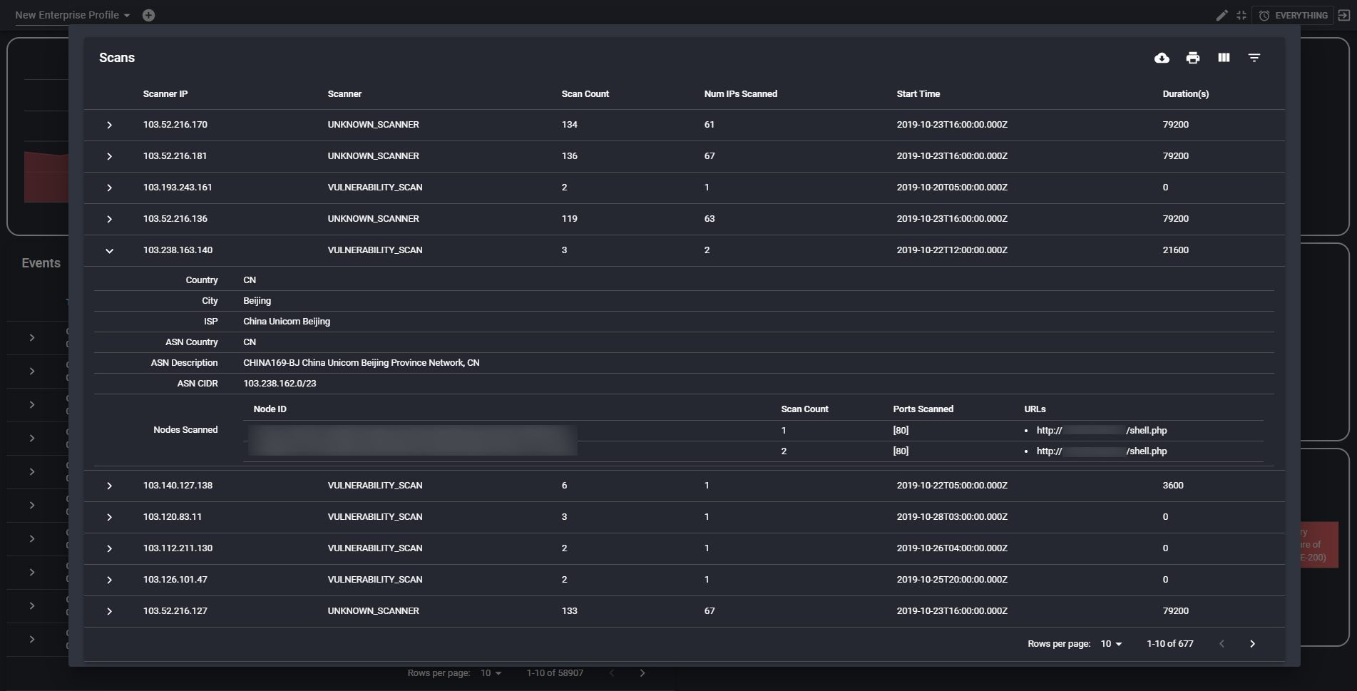

Slide 32
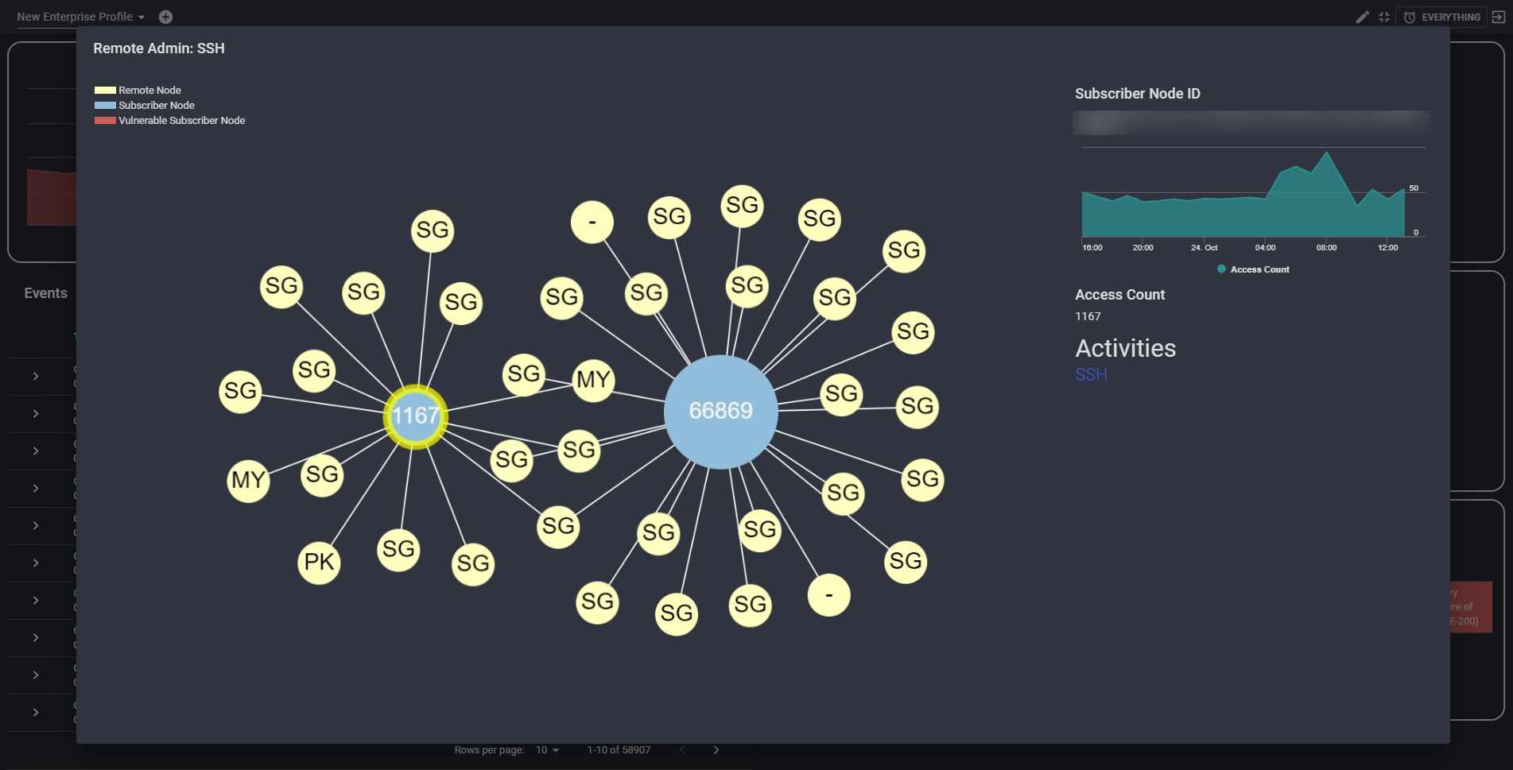

Slide 33
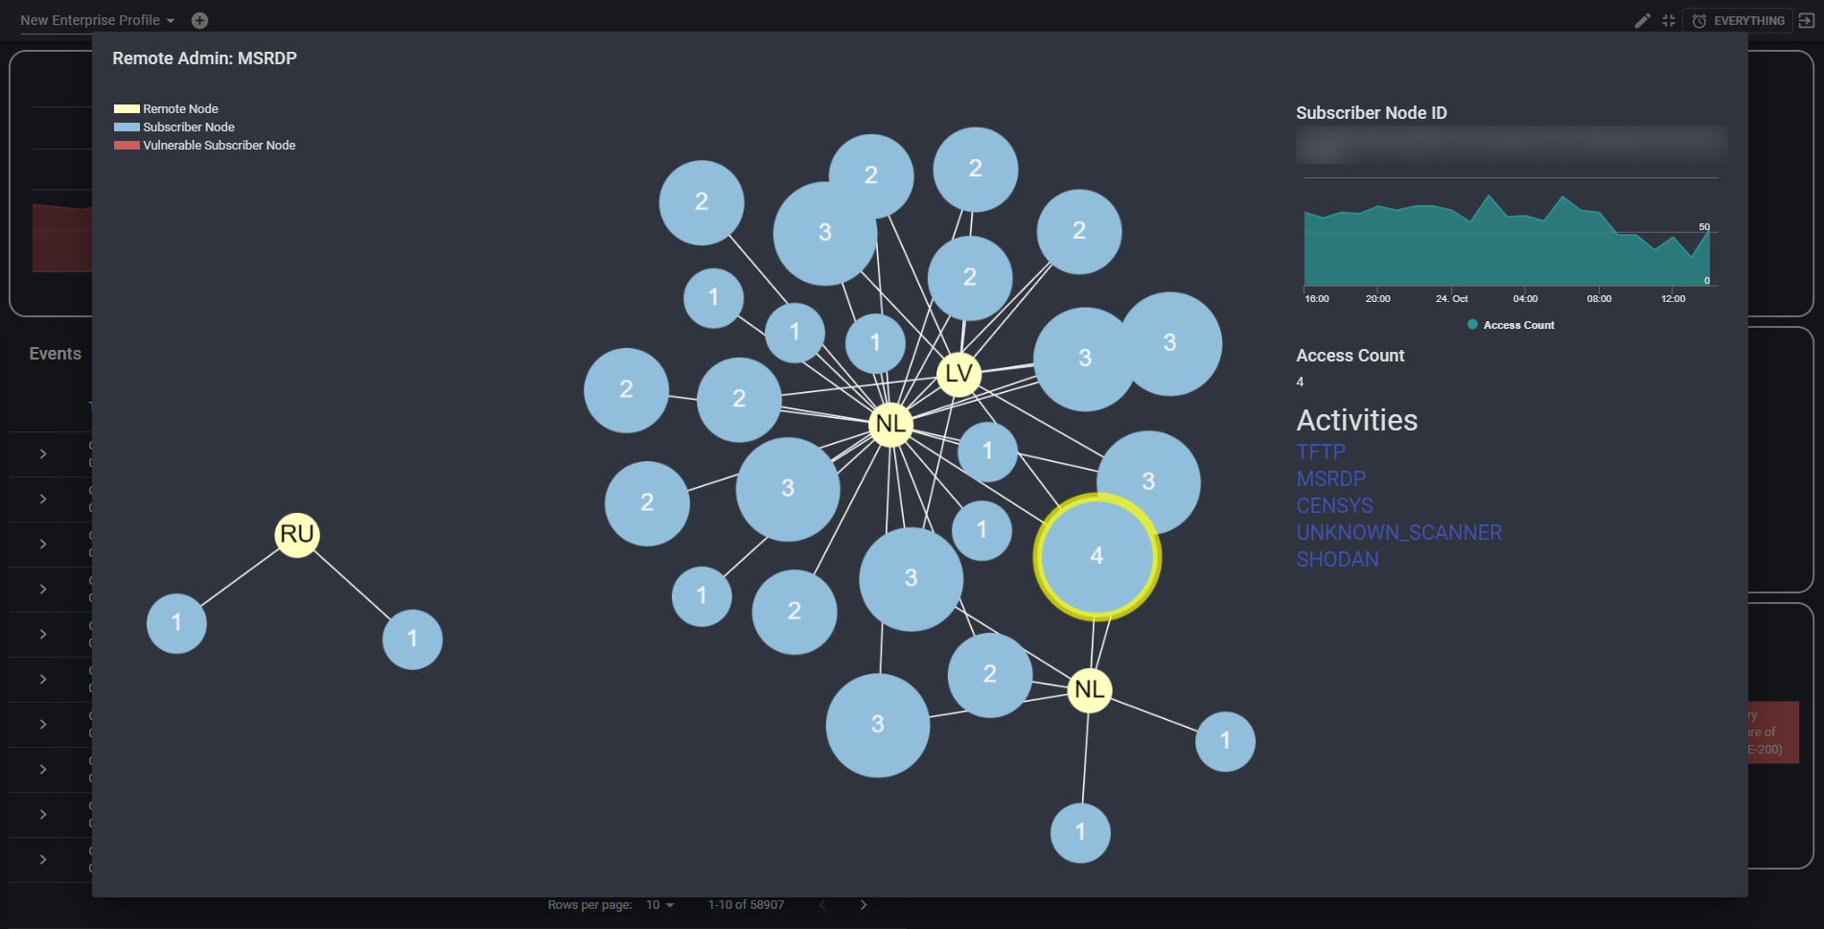

Slide 34
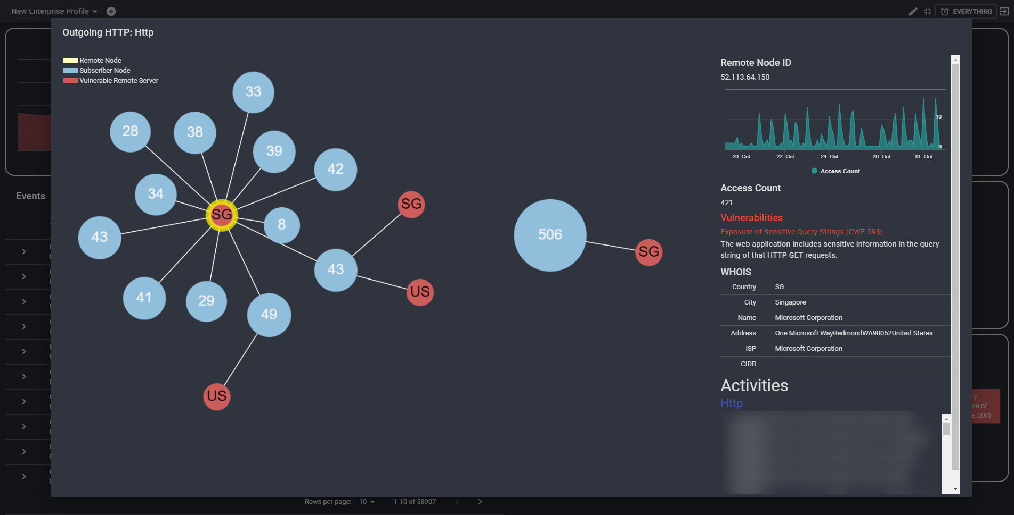

Slide 35
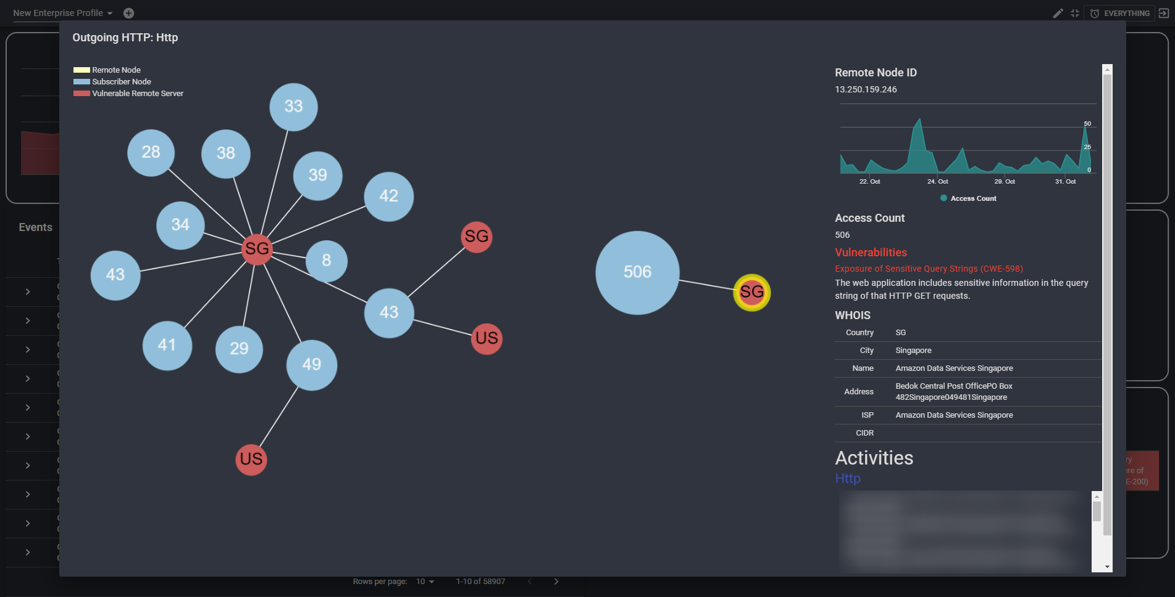

Slide 36
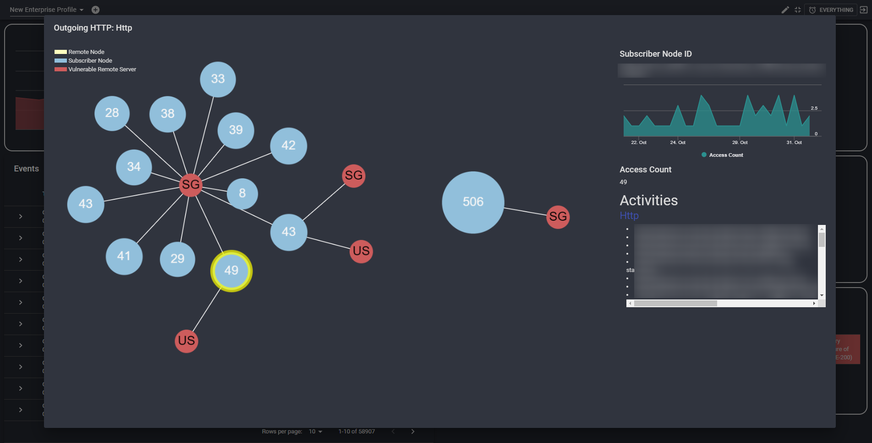

Slide 37
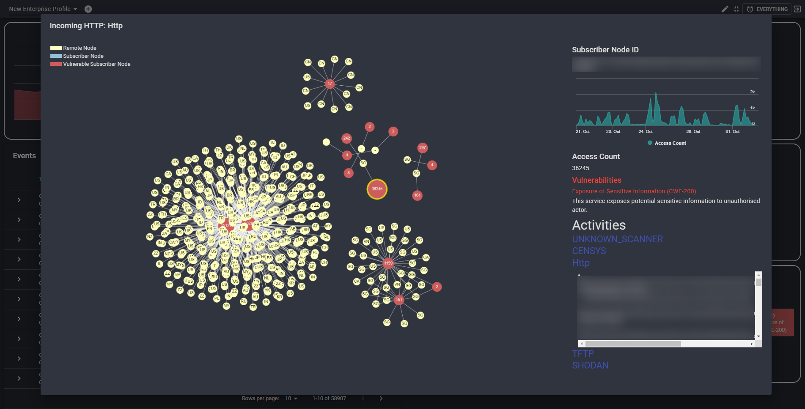

Slide 38
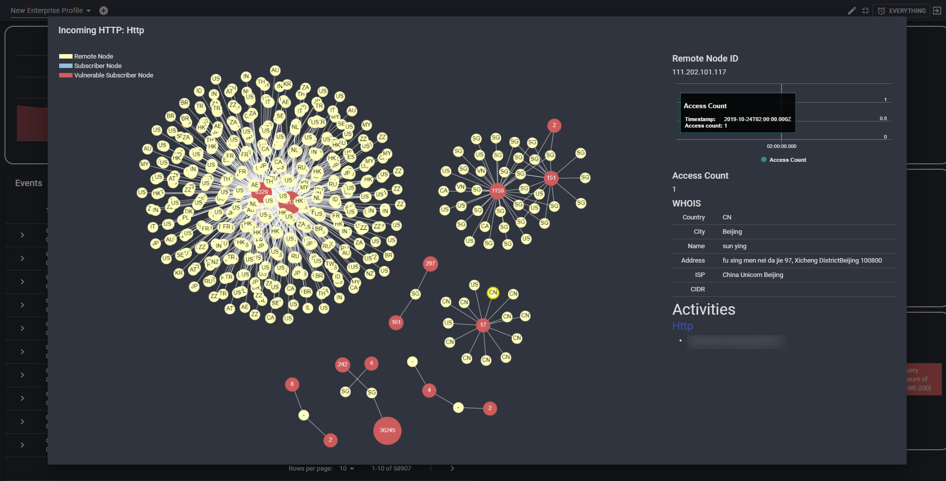

Slide 39
Labelled

Slide 40
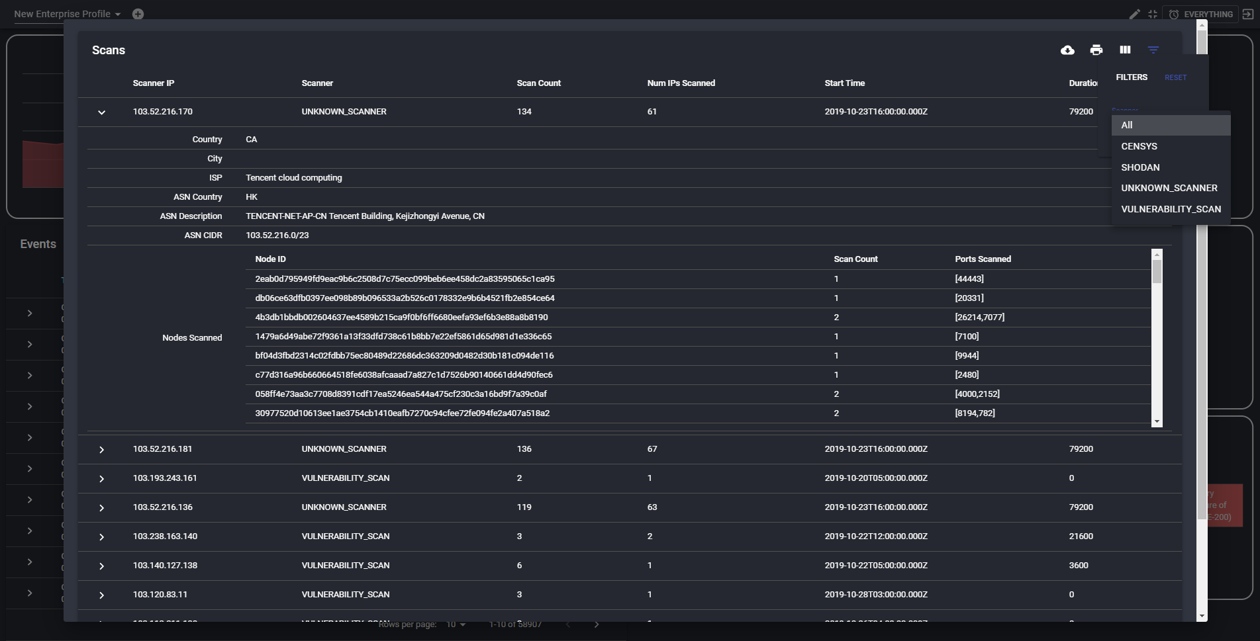

Slide 41
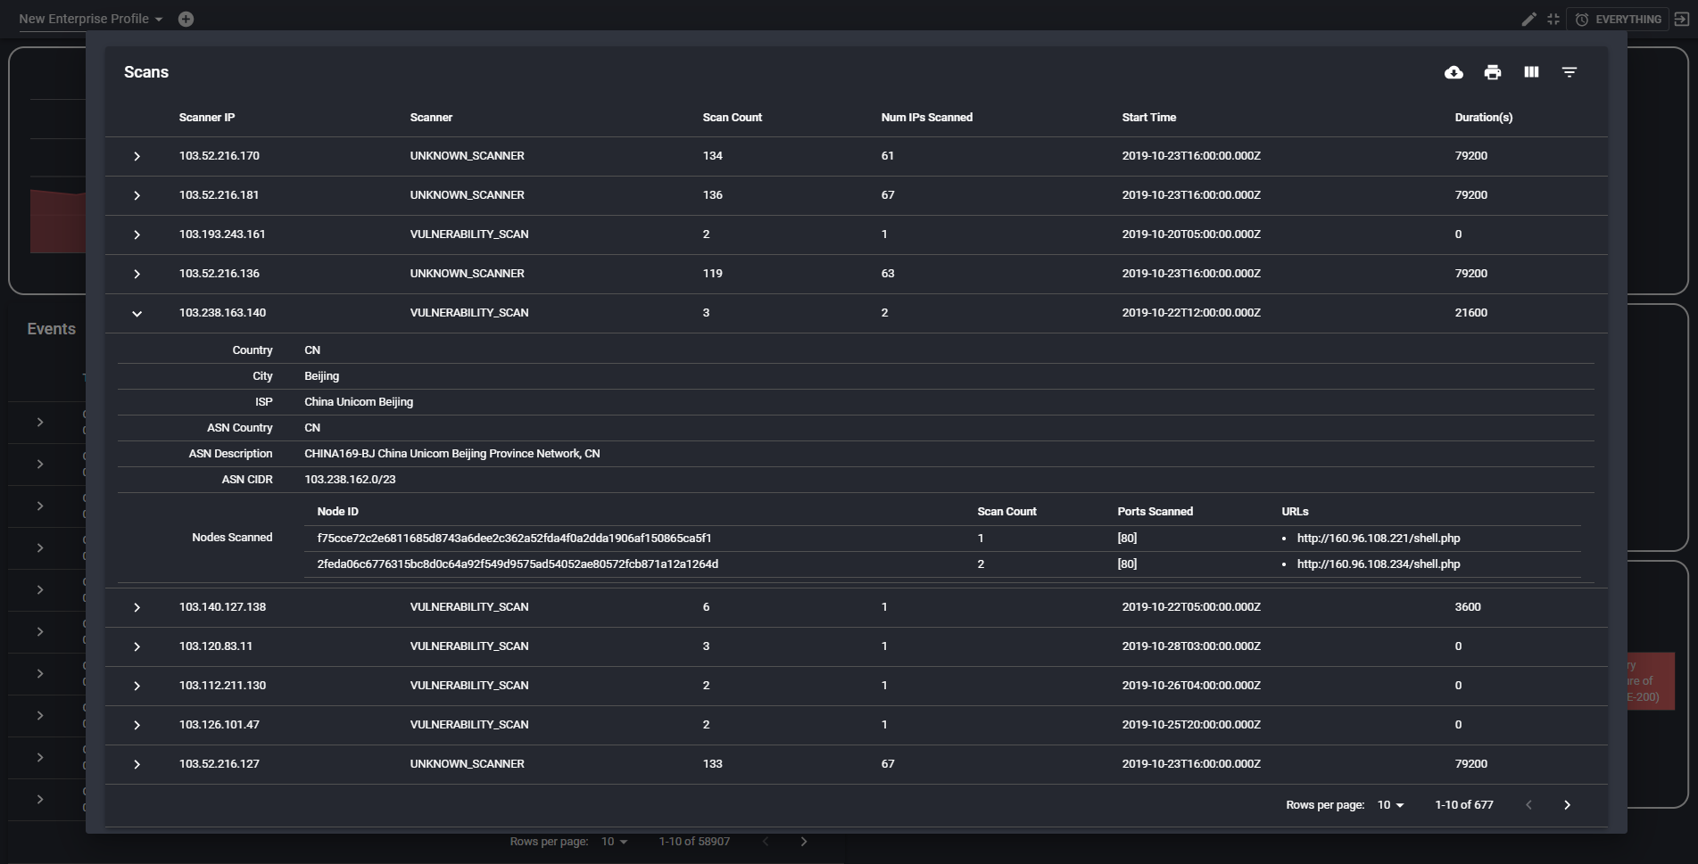

Slide 42
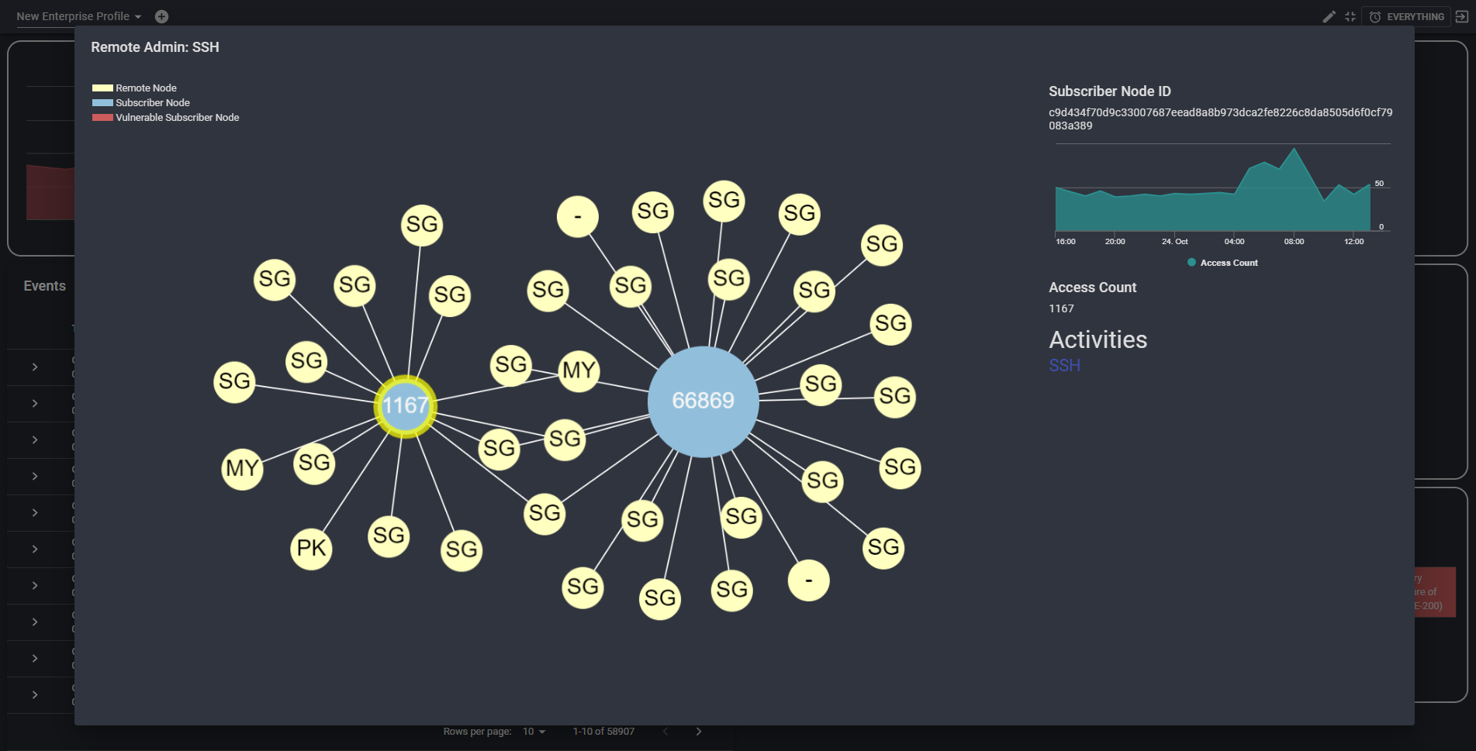

Slide 43
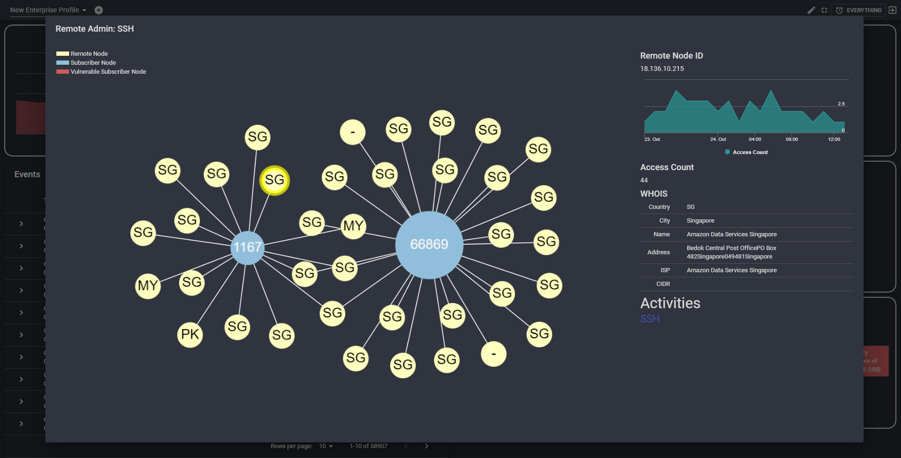

Slide 44
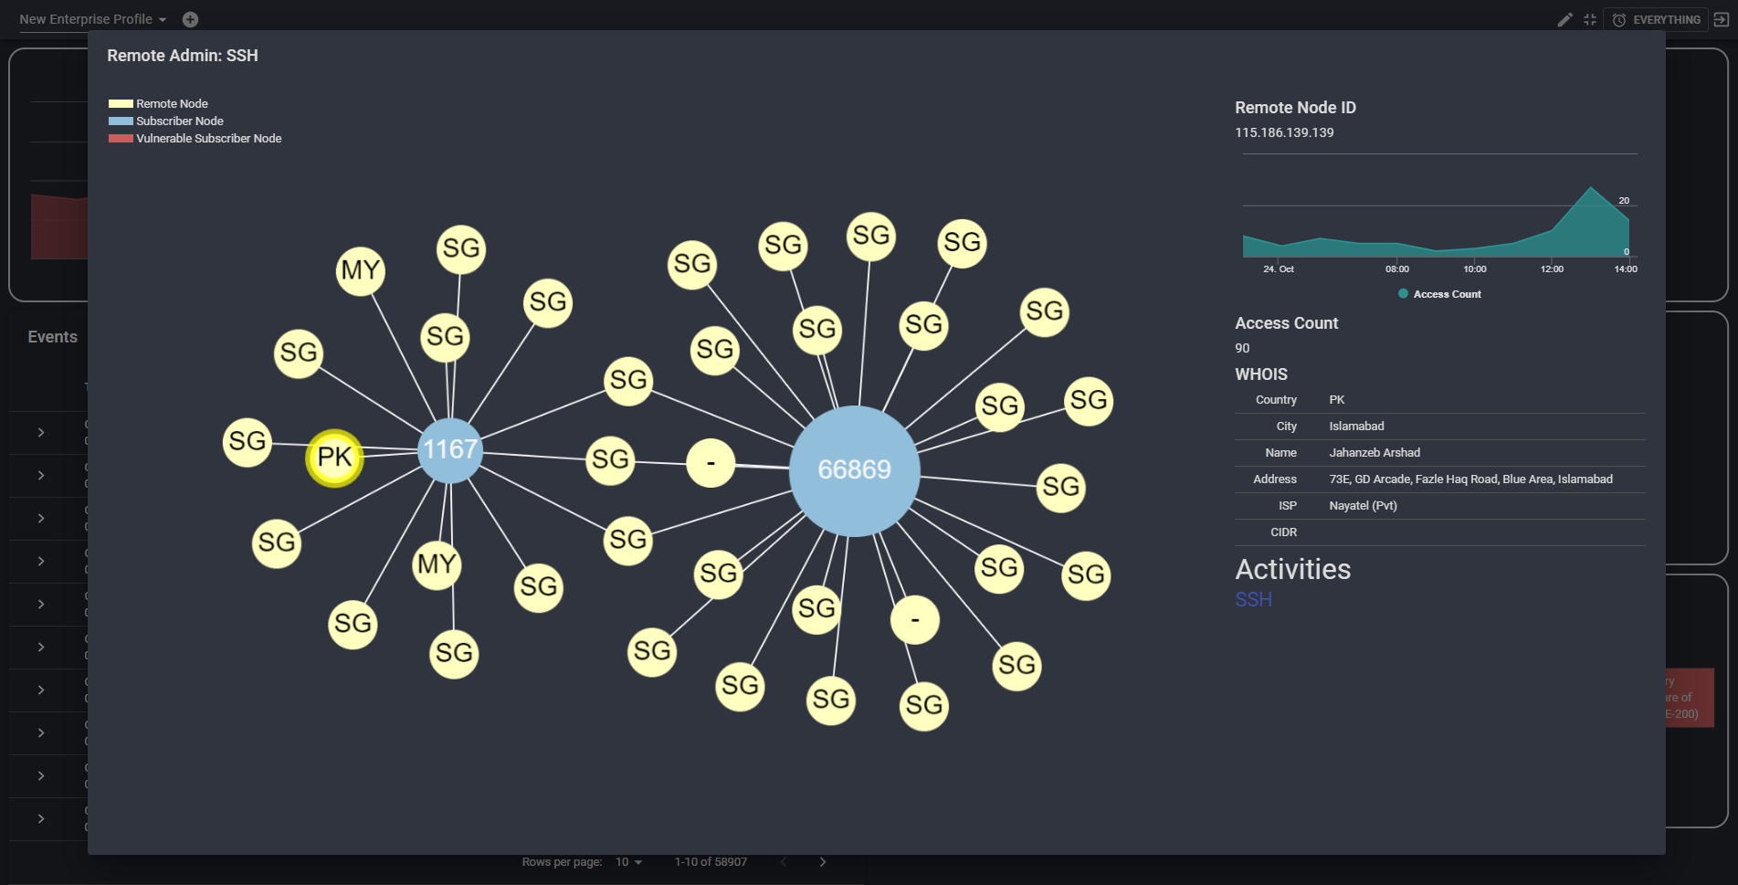

Slide 45


Slide 46
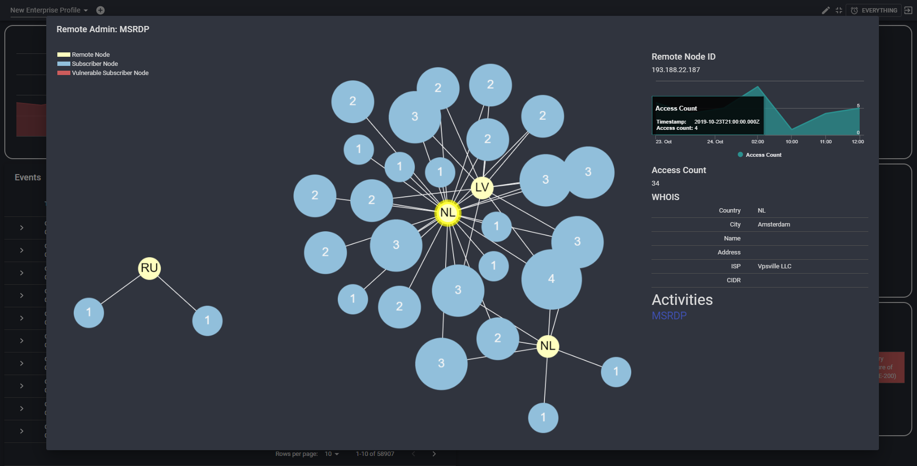

Slide 47
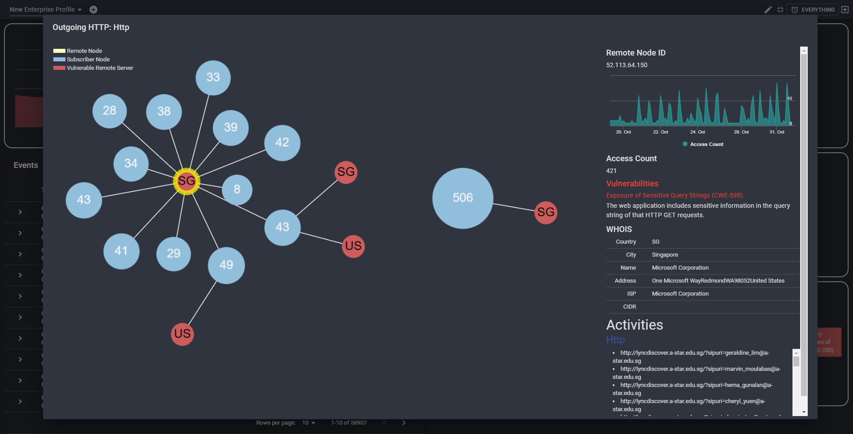

Slide 48
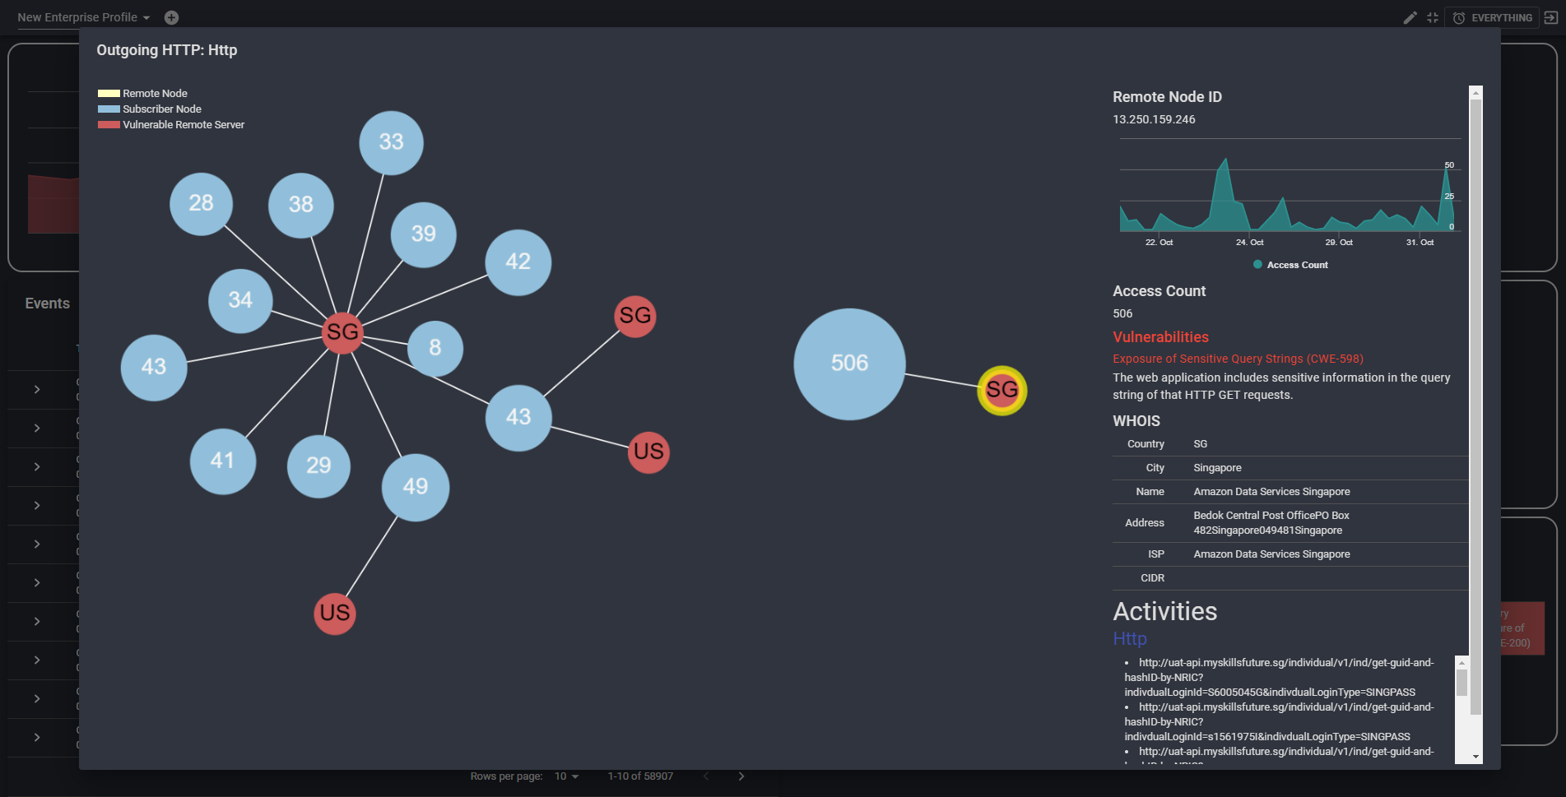

Slide 49
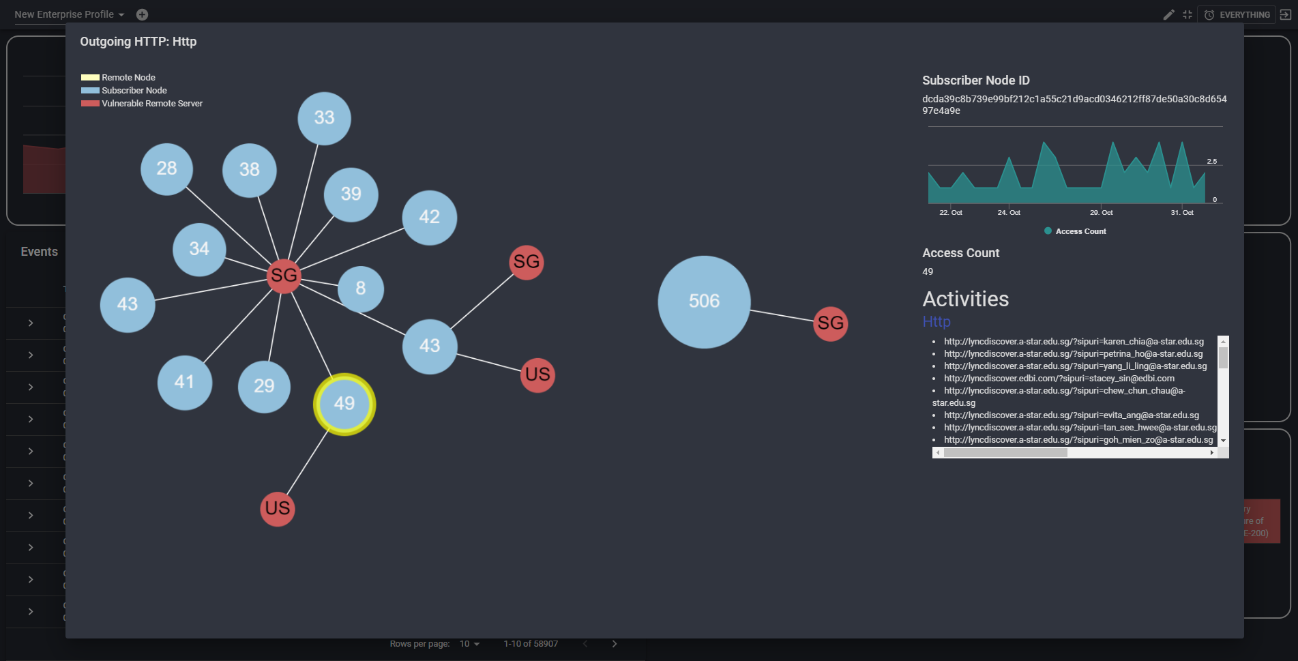

Slide 50


Slide 51


Slide 52
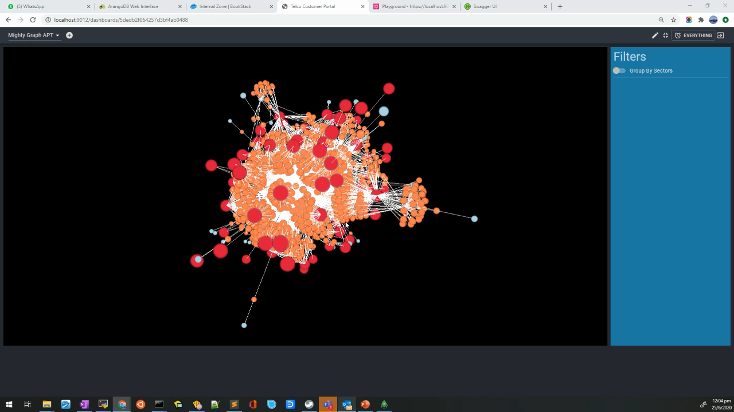
Mighty Graph APT Video

Slide 53
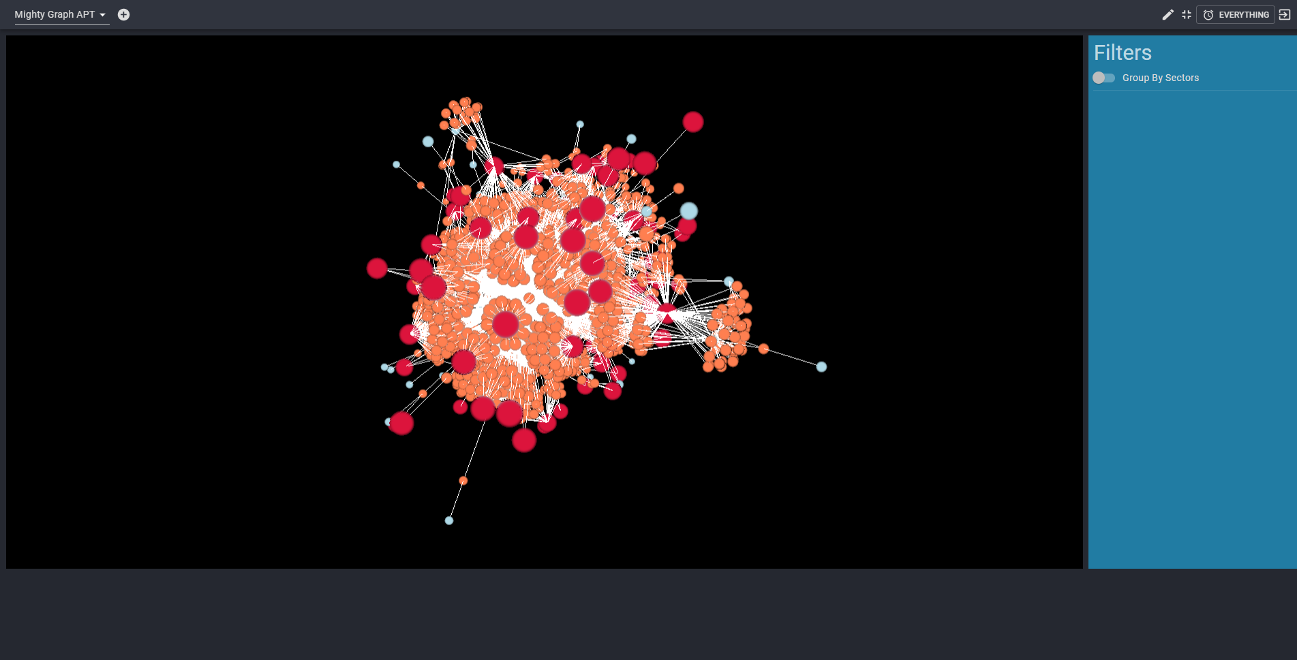

Slide 54
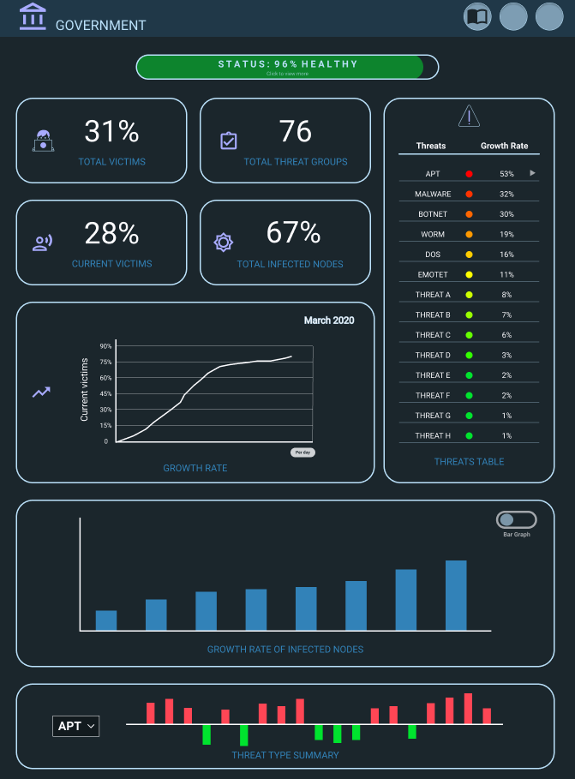
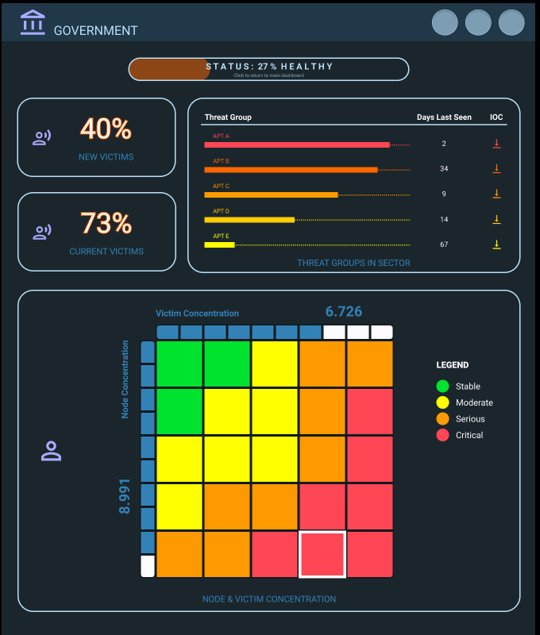

Slide 55


Slide 56



Slide 57


Slide 58


Slide 59

Asset Map
Asset with alerts will be flagged out immediately in the asset map. The user will be able to click on the asset to build the context of the flagged alert immediately
any abnormal OT communication happening with this flagged asset? (Top left corner)
If a new firmware is uploaded, what would be uploaded? (Top right corner’s Asset info)
What other alerts has happened? Is it a chain of attack? (Top bottom corner’s alert list)

Slide 60

Timeline Analysis
The timeline view allows the user to immediately identify the possible chain of events that happen among the assets. The color separation (red and purple) helps the user to differentiate events that involved OT devices (e.g. PLC) and OT workstations (e.g. SCADA server).

Slide 61

Enterprise – Homepage

Slide 62

Enterprise – Threat Type

Slide 63

Enterprise – Tor

Slide 64

Enterprise – Emerging Threat

Slide 65

Enterprise – Remote Admin

Slide 66

Enterprise – Scans

Slide 67

National

Slide 68

National – Top Threat Type (Emotet Link)

Slide 69

National – Top Threat Type (IoC Table)

Slide 70

National – Top Threat Actor

Slide 71

National – Emerging Threat

Slide 72

National – Sector Threat Count (Link)

Slide 73


Sectorial Dashboard (Government)

Slide 74

Sectorial Dashboard (Government)

Slide 75

Sectorial Dashboard (Government)

Slide 76


Sectorial Dashboard (BANKING AND FINANCE)

Slide 77

Sectorial Dashboard (BANKING AND FINANCE)

Slide 78

Sectorial Dashboard (BANKING AND FINANCE)

